Slide 1
More than Somewhat…Torrens
By David J. Meyers

Slide 2
David J. Meyers is the Examiner or Deputy Examiner of Titles for several Minnesota Counties. He is a member of the Titles Standards Committee, Survey Guidelines Subcommittee and Real Property Certification Board.
In 2019, he was elected a Fellow to the American College of Real Estate Lawyers.

Slide 3
Torrens Workshop
Minnesota Statutes Chapter 508 and 508A provides a guideline and some requirements for administering the Torrens system. Much of the Registrar’s work involves interpretation of these statutes and selecting the procedures that work best in their county.

Slide 4
An Application to Register Title
Record the Application in abstract and wait.

Slide 5
Order and Decree of Registration
Ask your Examiner to allow you to review a draft of the final Order before the Judge signs it.

Slide 6
    Ask yourself: What will the Certificate of Title look like?
      What is the Registrar supposed to do?

Slide 7
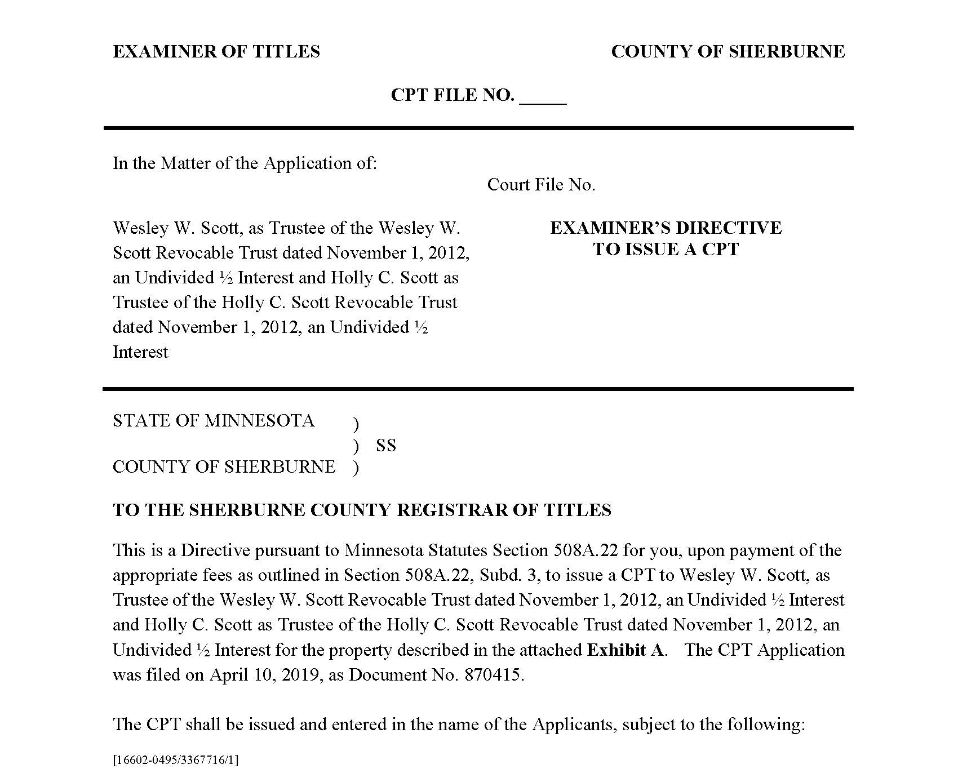

Slide 8
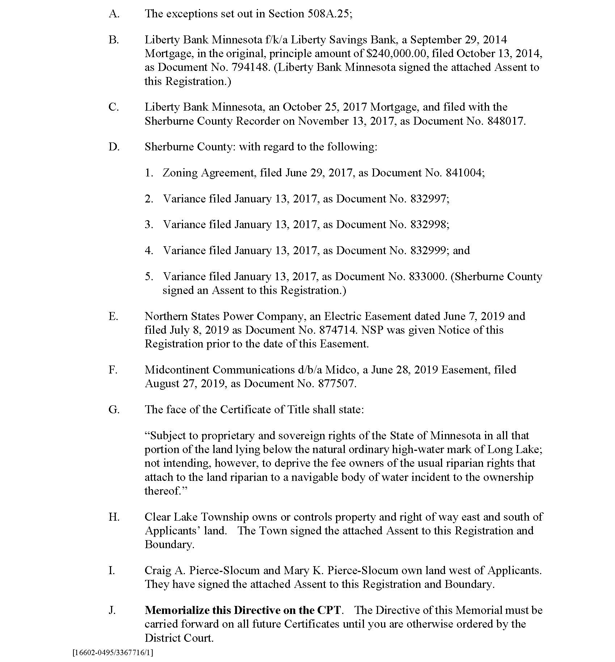

Slide 9
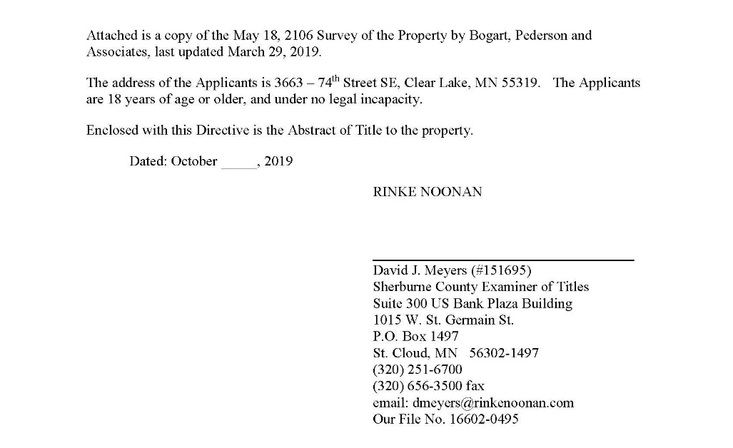

Slide 10
  What will be on the face of the Certificate?
  What will be memorials?
  How do abstract documents listed in the Order and Decree of Registration get from the Abstract system to Torrens?

Slide 11
  It is a good idea to have the Applicant file the Order in both the abstract and Torrens systems.
  Make sure the Auditor has reviewed the Order to correct the tax parcel records.

Slide 12
Recording fees?

Slide 13
Proceeding Subsequent to Initial Registration -
What is it and Why is it done?
  Correct the Certificate of Title due to a non-voluntary conveyance
    Mortgage foreclosure, real estate tax forfeiture, etc.

Slide 14
  To remove outdated or problem memorials
    A Contract for Deed after cancellation
    Mortgages or other liens where the debt has been paid, but a satisfaction or release is not available.

Slide 15
  To resolve a boundary dispute
  Determine rights in an unregistered claim of interest
  Original deed cannot be found for recording

Slide 16
Generally, any action needed to clear a Certificate of Title when the Registrar on their own, or by directive, cannot correct the problem.

Slide 17
Registrar memorializes a certified copy of the Petition on the Certificate of Title and waits.
  Ask your examiner to allow you to review drafts of unusual Orders.

Slide 18
Ask “What am I supposed to do?”
    Is the certificate to be cancelled, and a new certificate issued with some memorials dropped?
    In some cases, the Order is memorialized on the Certificate of Title with instructions to either carry it forward to drop memorials and make a change on the next transfer.

Slide 19
Certifications and Directives
Instructions from the Examiner to the Registrar to take an action.
The Examiner and Registrar should develop a list for use in their county.

Slide 20
The Examiner and Registrar should agree upon a form.

Slide 21
Some Certifications and Directives are required by statute, others are at the request of the Registrar.

Slide 22
The Directive or Certification may be attached to the instrument, or it may be recorded separately.

Slide 23
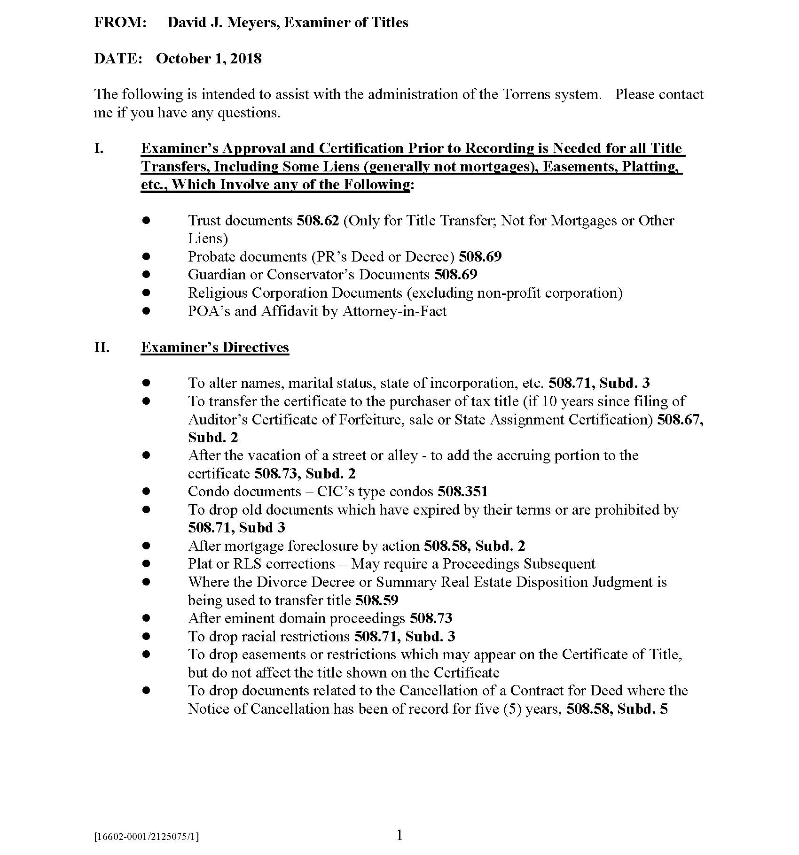

Slide 24
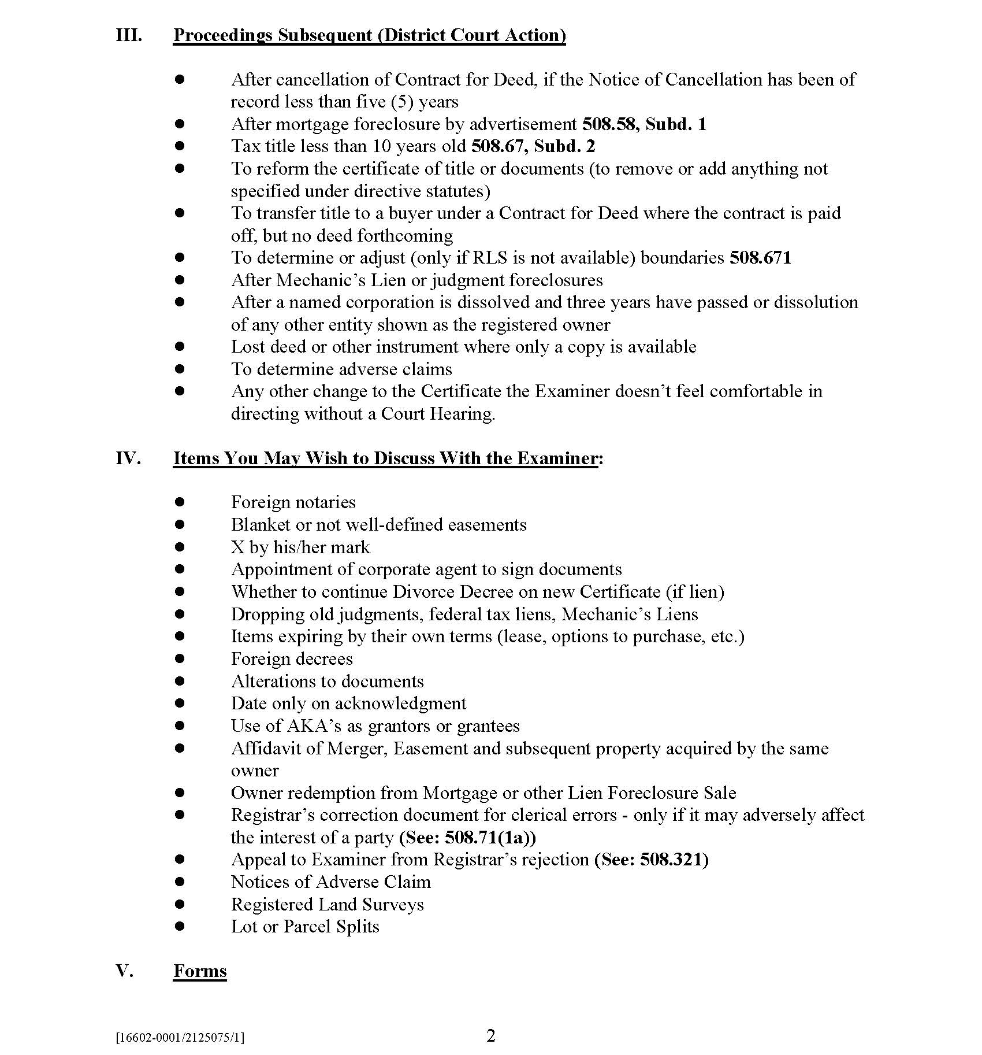

Slide 25
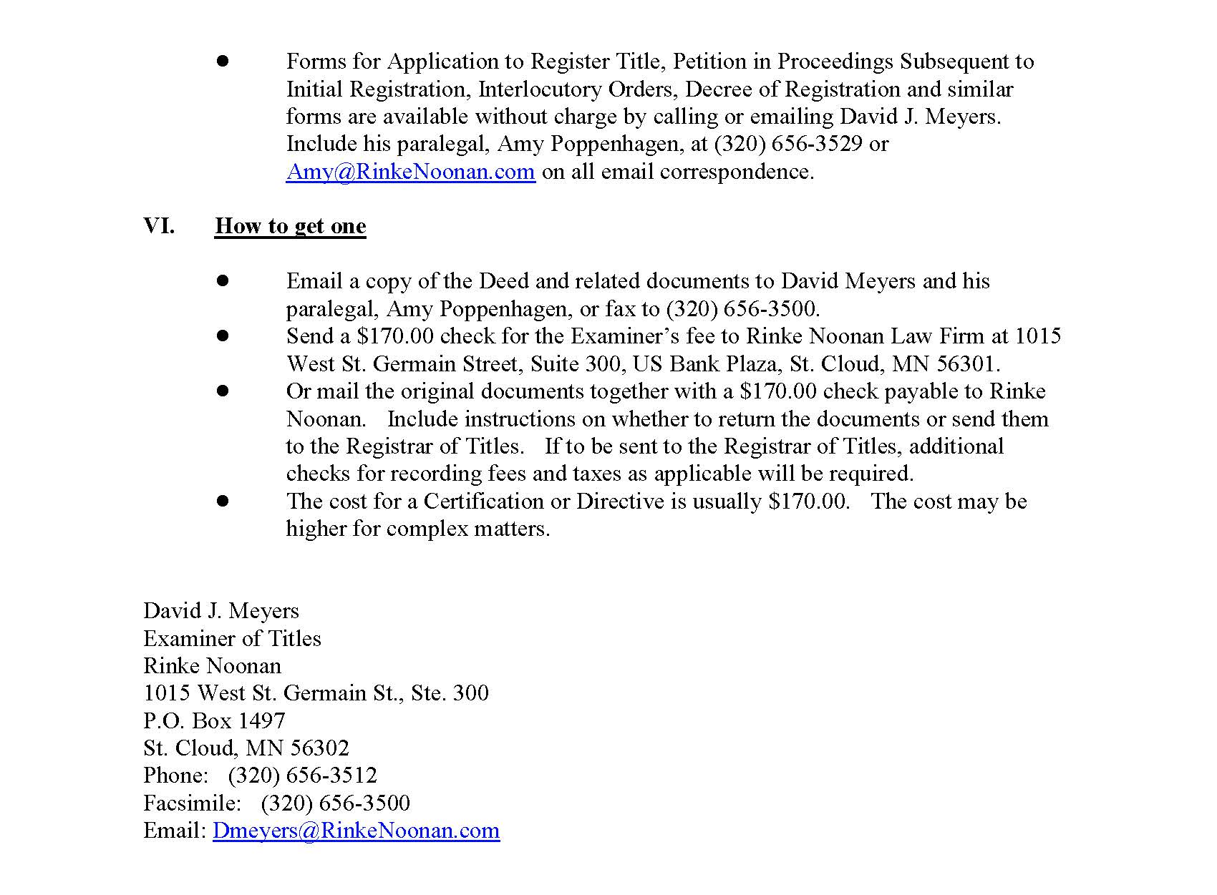

Slide 26
Registered Land Survey (RLS)
“The registrar of titles may require that the owner of parcel of unplatted registered land, who conveys any part thereof which is not a part full government subdivision or simple fraction or quantity part of a full government subdivision, shall first file with the registrar of titles a drawing in triplicate of said parcel of unplatted land, showing the tract or tracts to be conveyed, which drawing shall be known as a ‘Registered Land Survey.’” Minn. Stat. §508.47, subd. 2

Slide 27
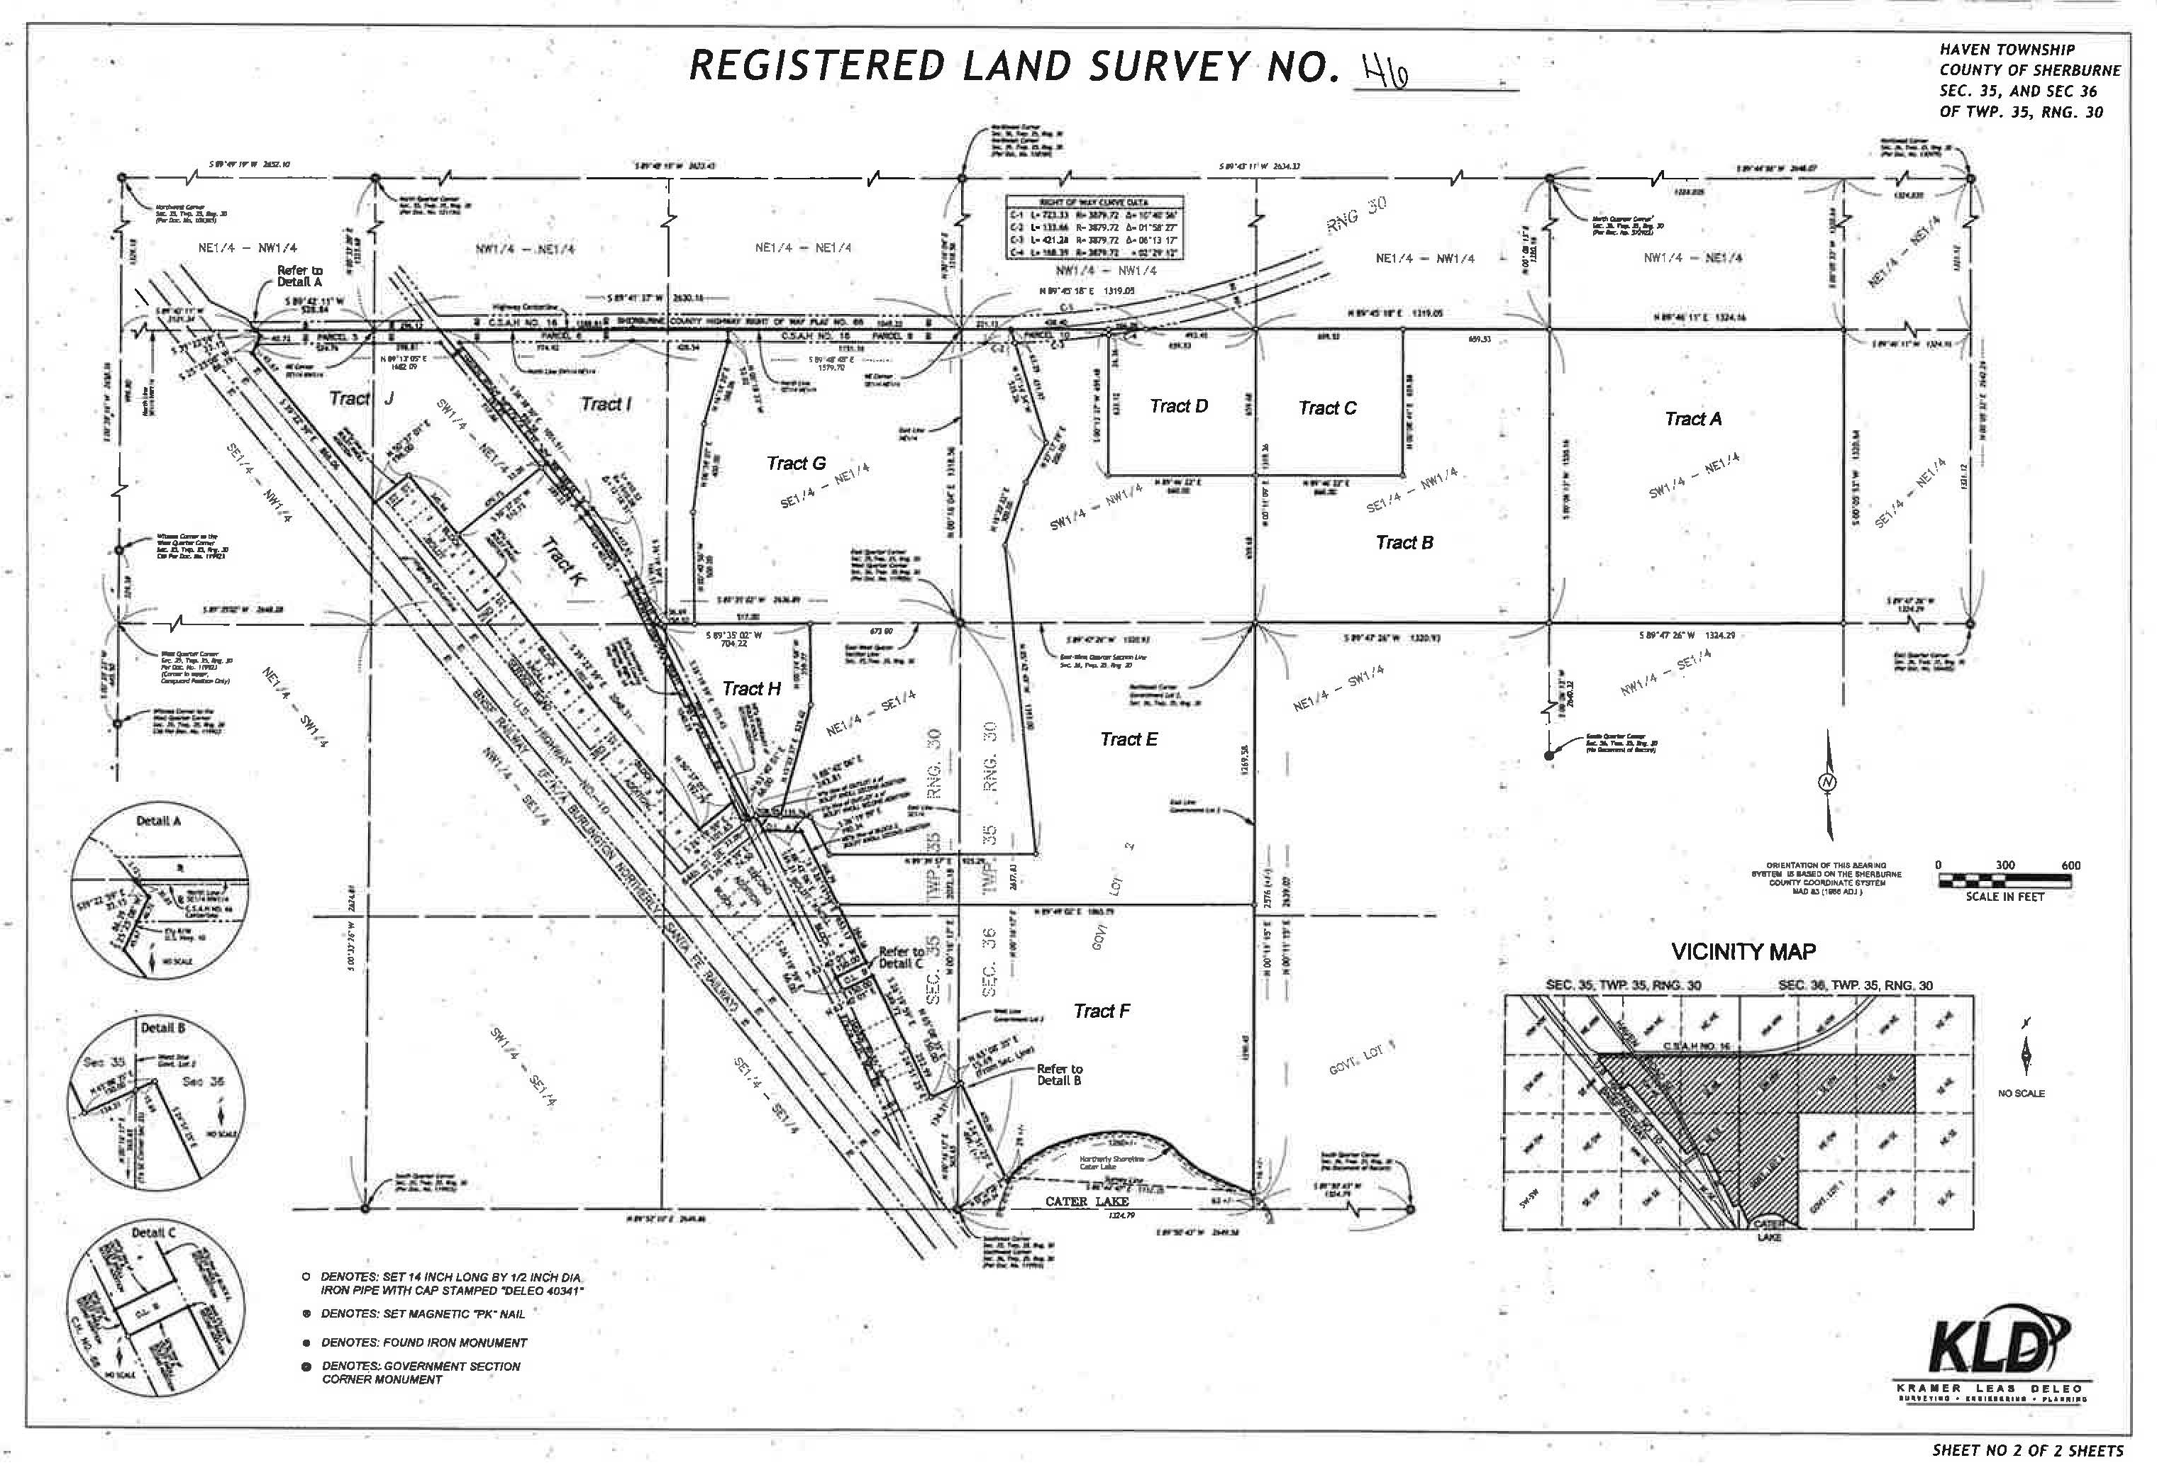

Slide 28
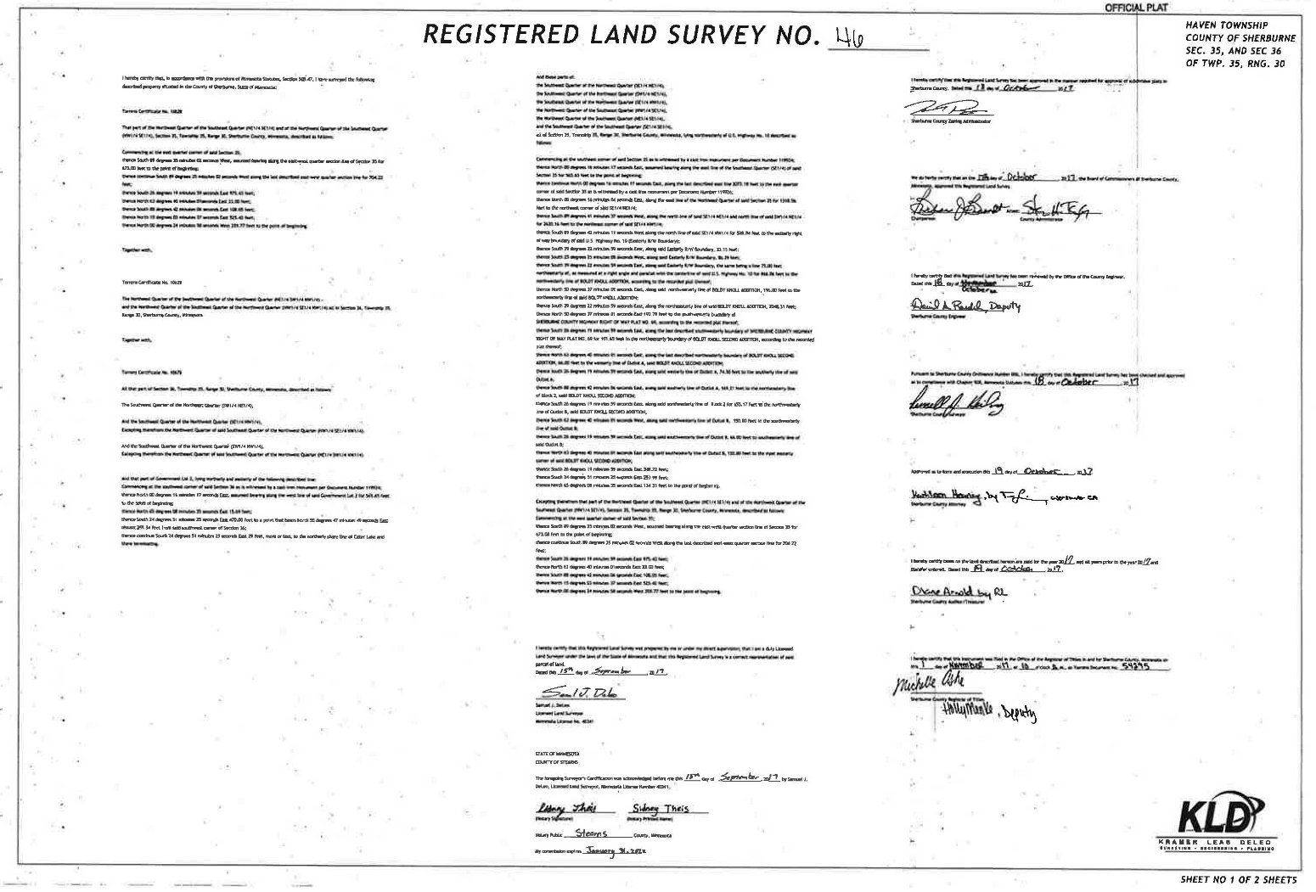

Slide 29
Should the Registrar require separate Certificates of Title for separate parcels?
It is a matter of keeping the record straight.

Slide 30
Do not allow a Certificate of Title to become a complex abstract

Slide 31
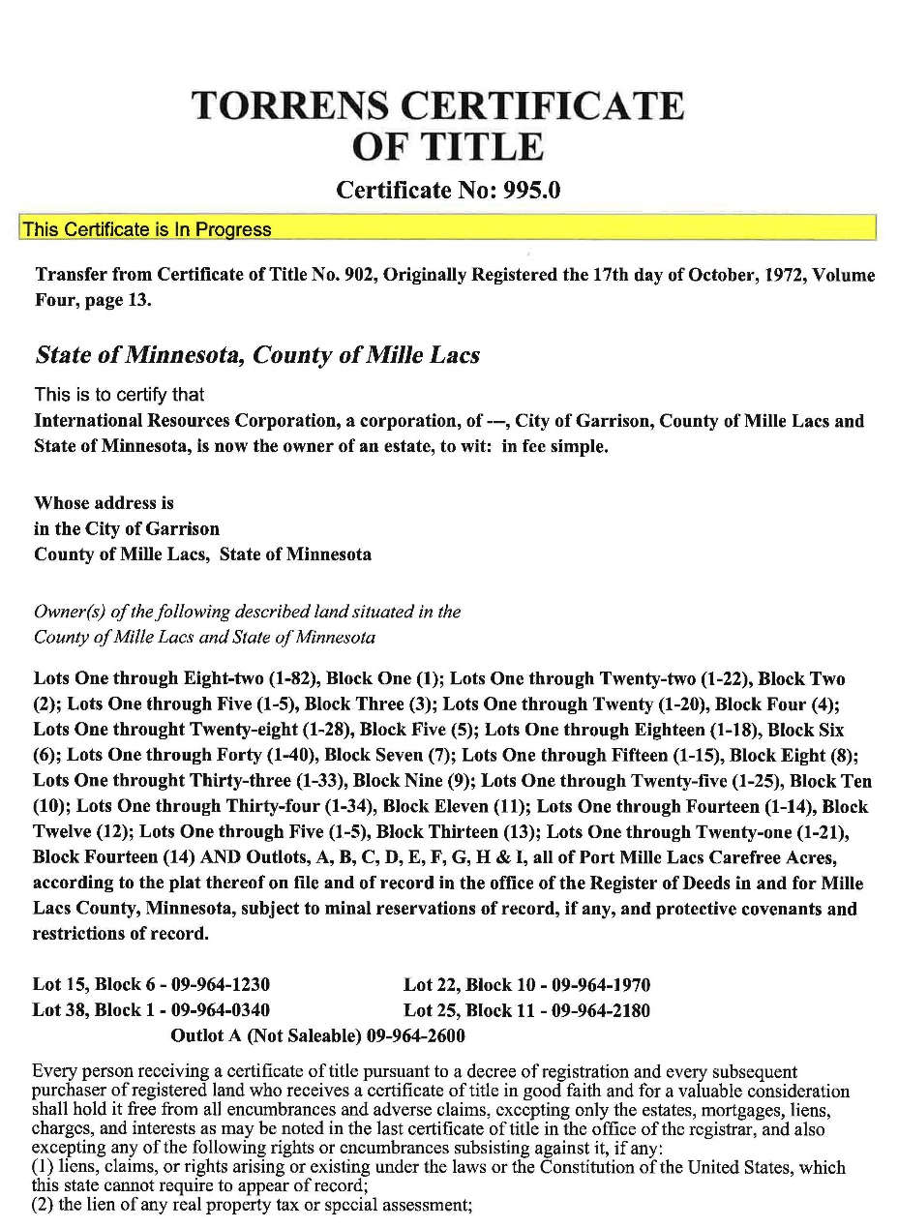

Slide 32
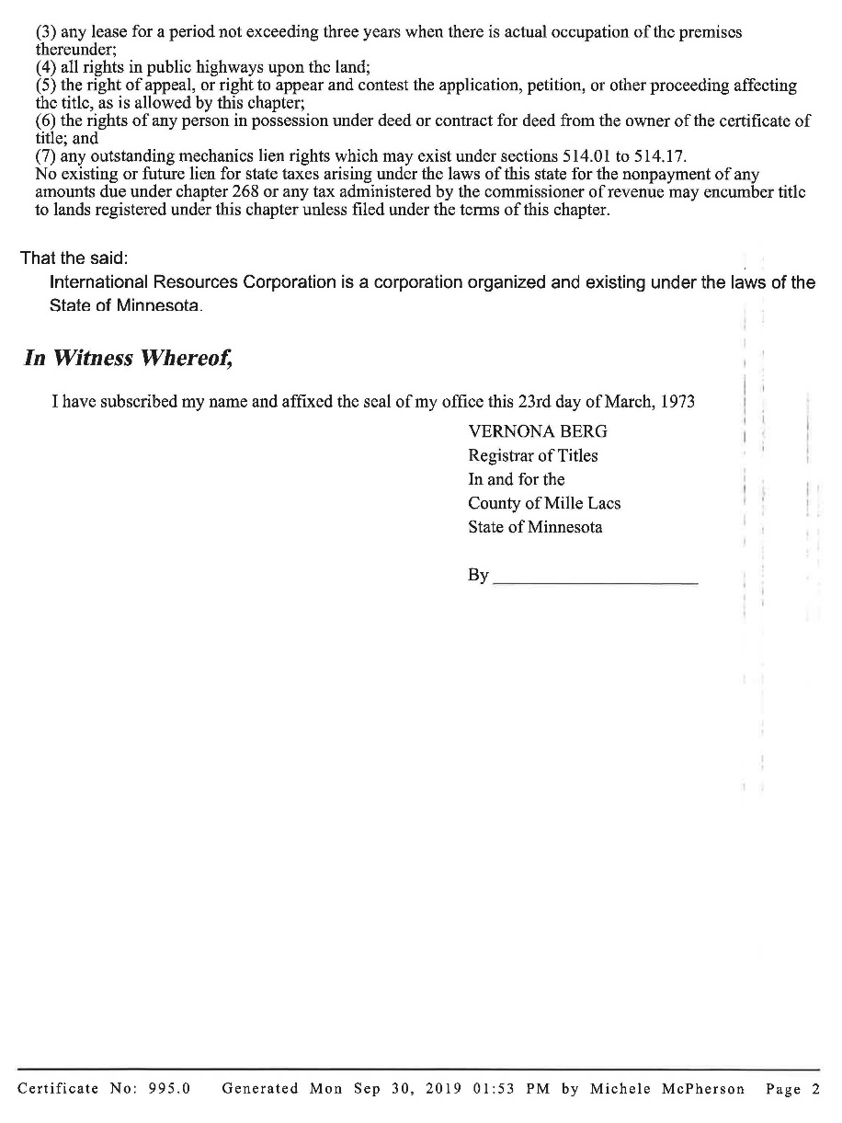

Slide 33
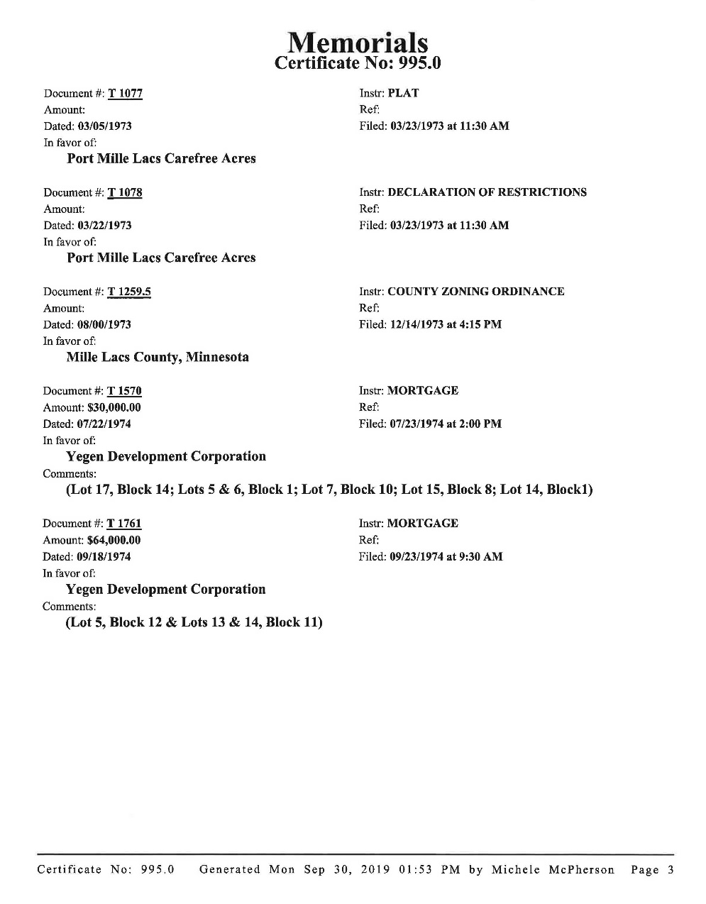

Slide 34
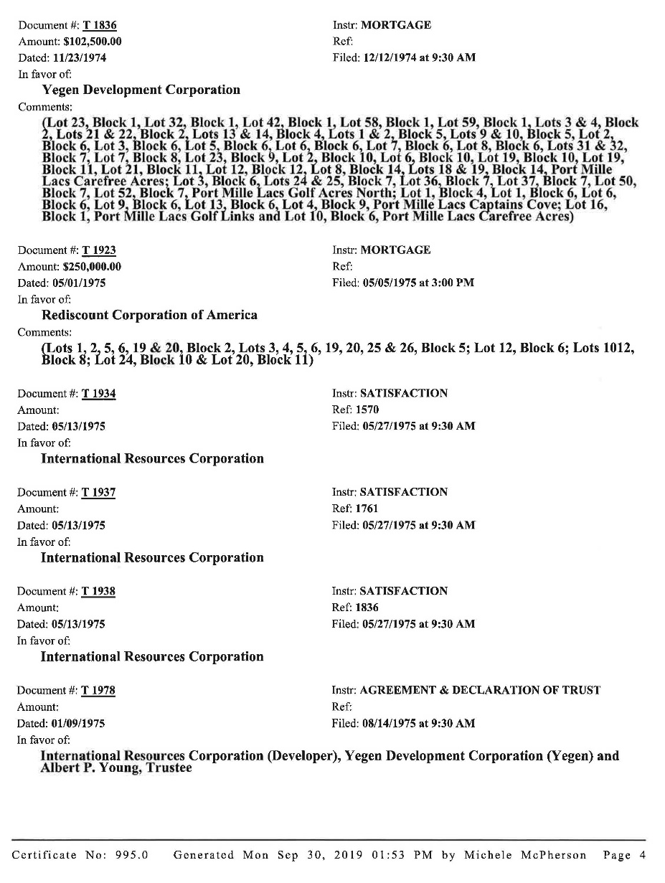

Slide 35
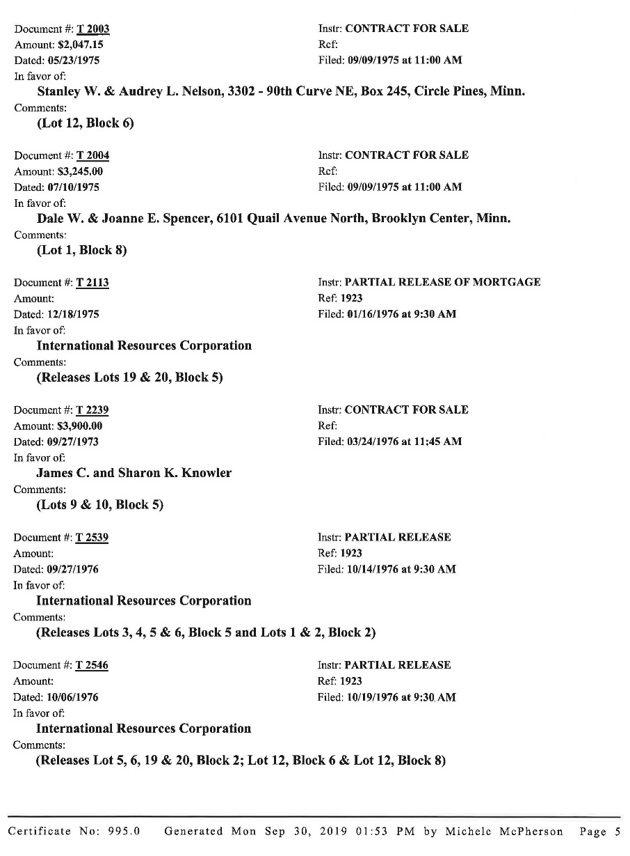

Slide 36
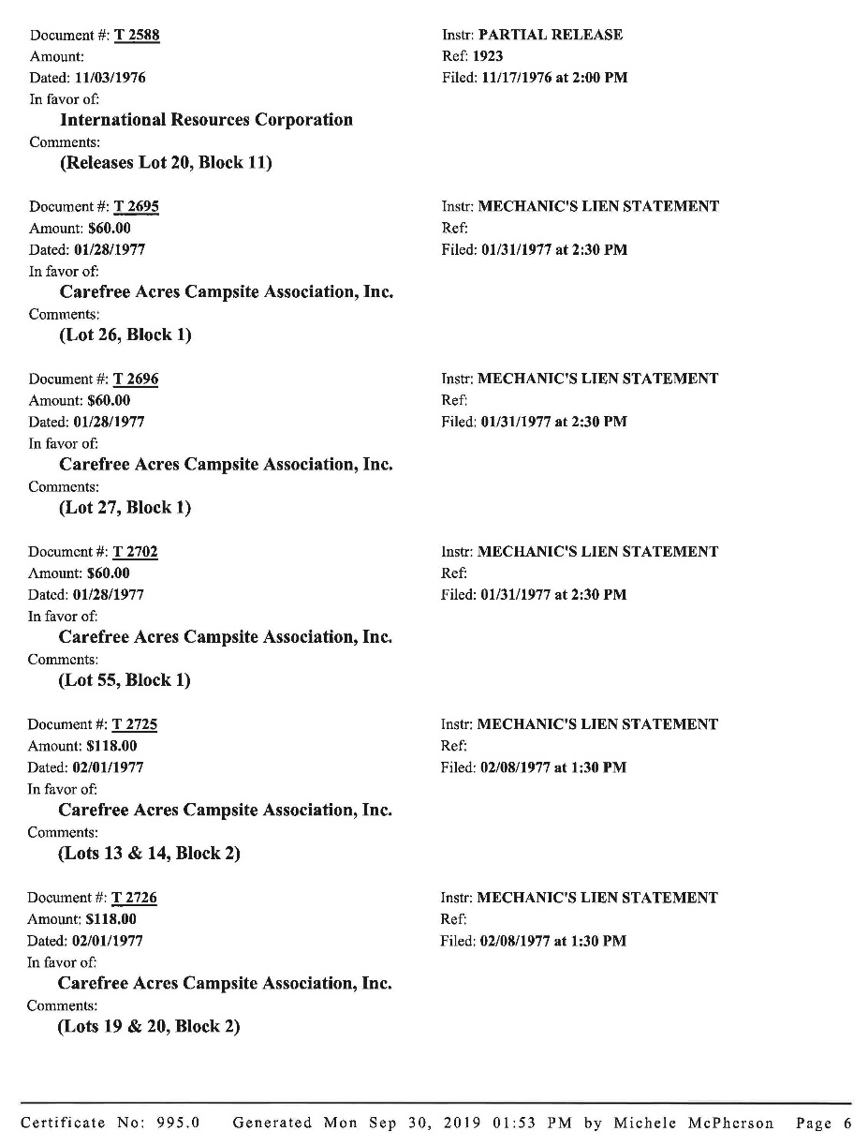

Slide 37
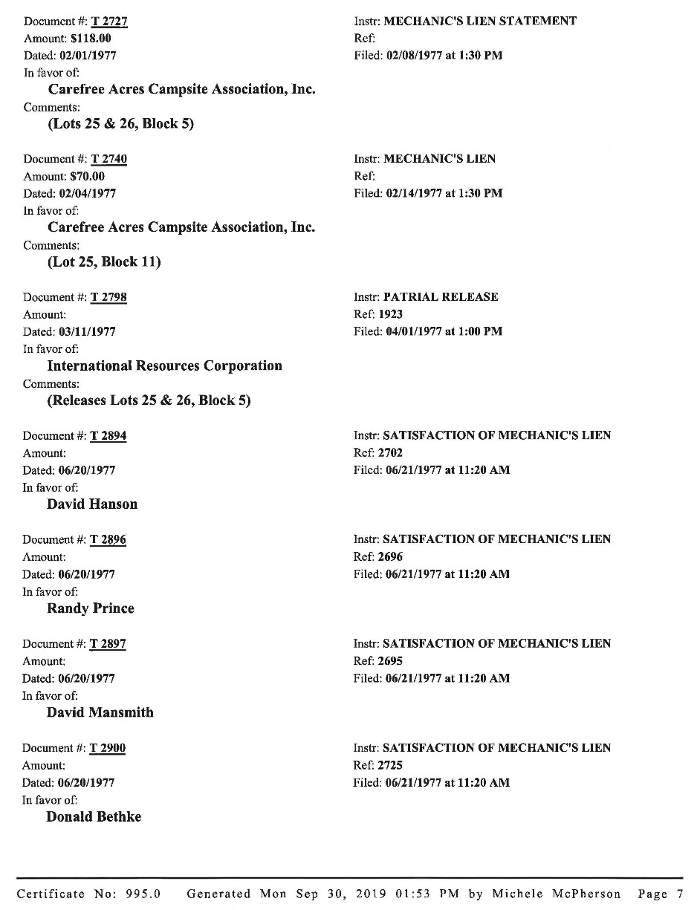

Slide 38
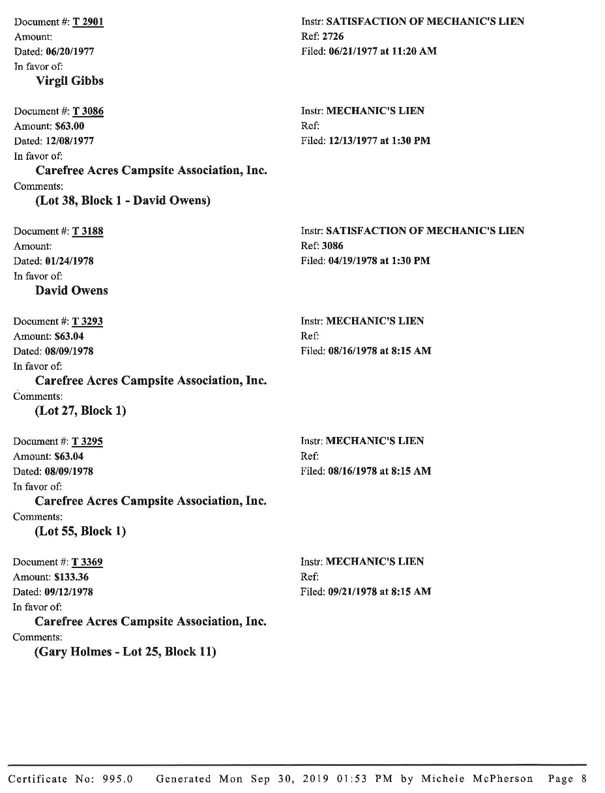

Slide 39
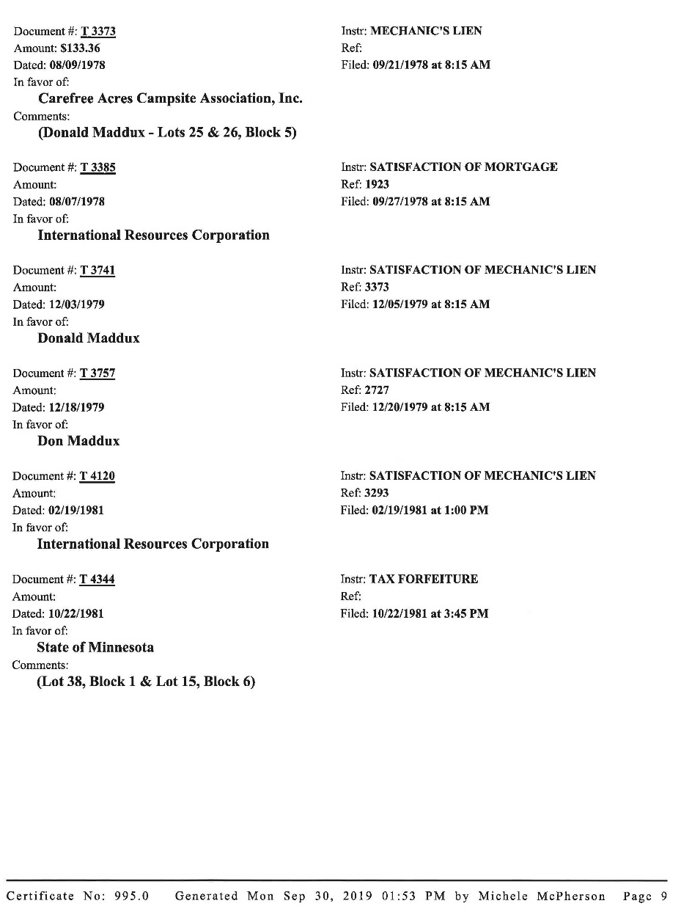

Slide 40
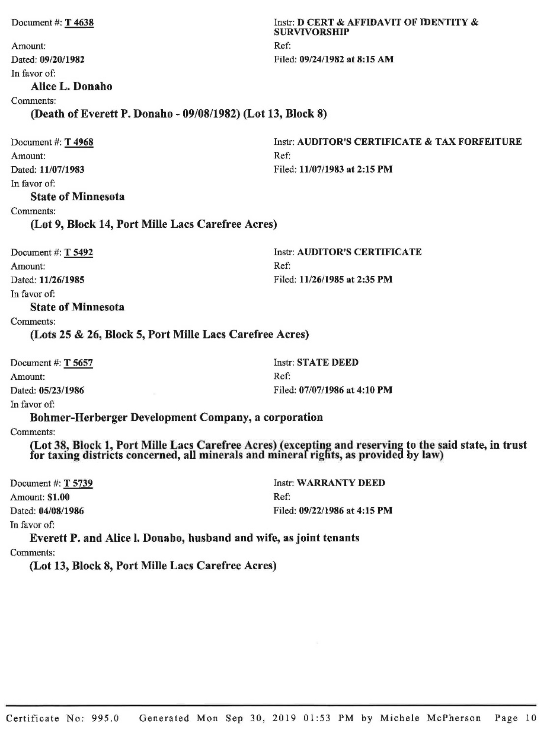

Slide 41
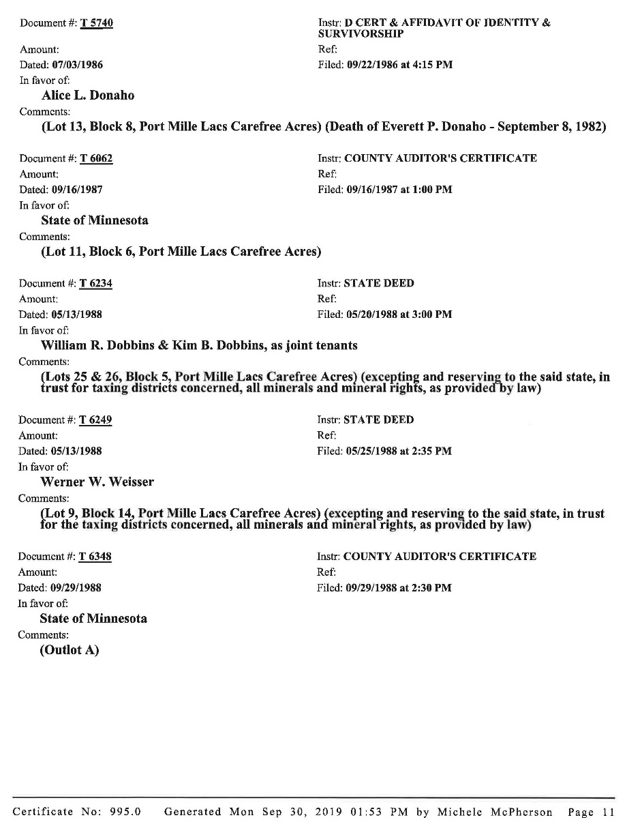

Slide 42
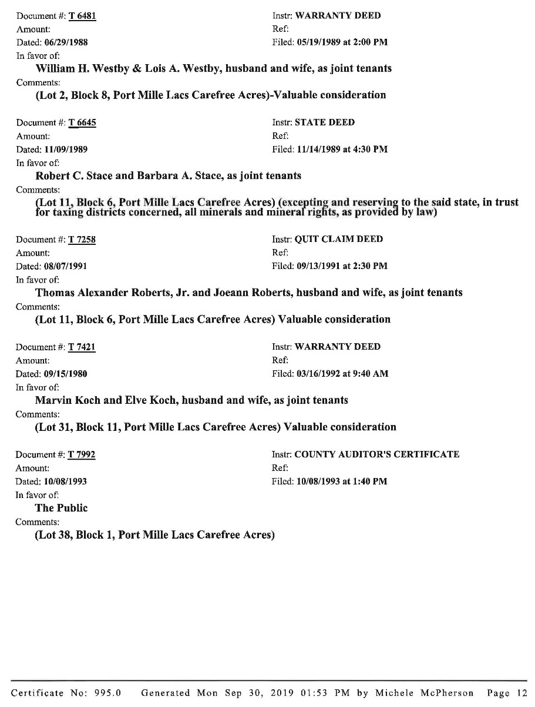

Slide 43
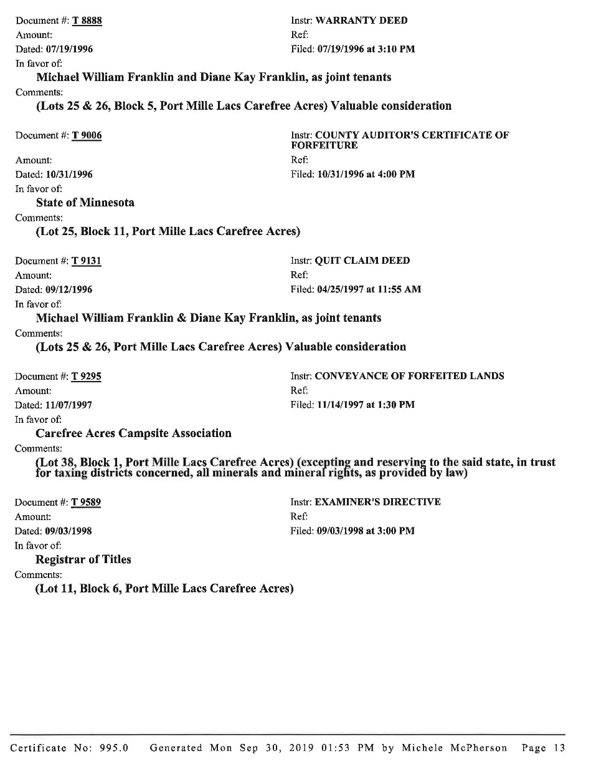

Slide 44
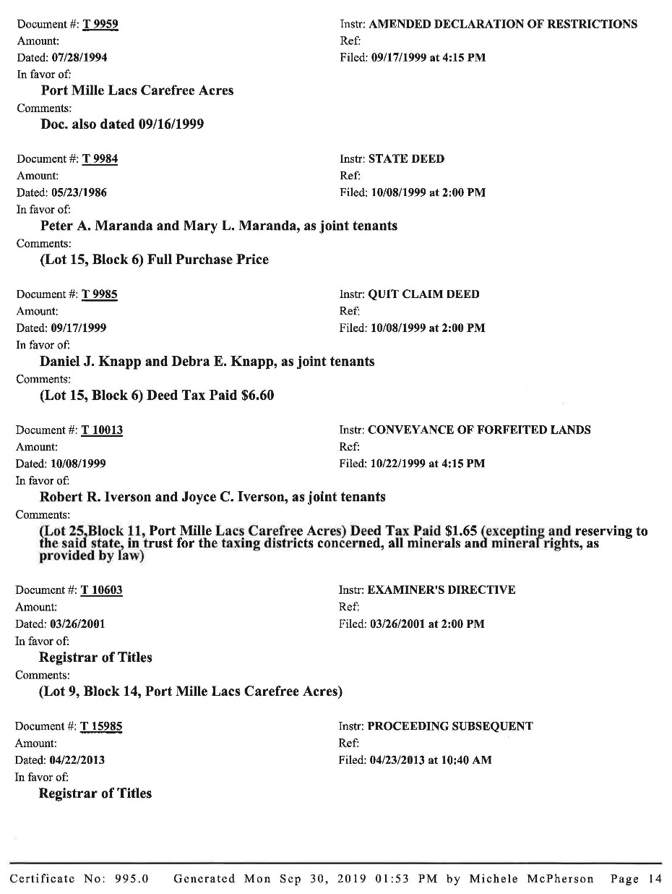

Slide 45
Dealing with an Examiner of Titles

Slide 46
The Examiner of Titles is appointed by the Judges of the District Court.

Slide 47
The Registrar should get involved in selecting the Examiner and recommending the appointment to the District Court.

Slide 48
Few lawyers practice real estate that involves examining or drafting documents. Fewer still have an in-depth knowledge of the Torrens system.

Slide 49
Duty of the Examiner

Slide 50
The Examiner of Titles is the advisor to the Registrar. Minn. Stat. §508.12.

Slide 51
The Examiner of Titles has the authority to require the Registrar to accept a document for recording. Minn. Stat. §508.321.

Slide 52
The registrar and examiner should try to agree.

Slide 53
Registrars Authority to Correct a Certificate of Title

Slide 54
The Registrar may correct clerical errors or omissions made by Registrar staff. Minn. Stat. §508.71

Slide 55
If the error or omission affects the interest of a party, it must be referred to the Examiner. (material corrections)

Slide 56
Walther v. Lundberg, Lincoln County Registrar of Titles, 654 NW2d 694 (Minn. 2007)

Slide 57
When should a Registrar reject a document?

Slide 58
Should a deed and mortgage be memorialized prior to the completion of a proceeding subsequent after mortgage foreclosure?

Slide 59
Thank you!
David J. Meyers
Rinke Noonan
Phone: 320.251.6700
Toll Free: 888.899.6700
Direct Dial: 320.656.3512
Email: Dmeyers@rinkenoonan.com

