Slide 1




MCRA Summer Conference
June 13th- 16th 2017
Ruttger’s Bay Lake Lodge

Slide 2
Torrens Basics
Cheryl Perish Todd County Registrar of Titles and Country Recorder
cheryl.perish@co.todd.mn.us
Robert Russell Russell Law Office, Otter Tail County
Examiner of Titles
Robert@russelllawoffice.com
Wayne Anderson Ramsey County Examiner of Titles
Wayne.Anderson@CO.RAMSEY.MN.US
David J. Meyers Sherburne, Mille Lacs, Roseau, Kittson, Marshall and
Wilkin County Examiner of Titles
dmeyers@rinkenoonan.com

Slide 3
What is the status of a Condition of Register?
• MN Statute 508.82, Subd 1 (7) and
508A.82, Subd 1 (7)

Slide 4
Should an Application to Register Title be indexed against adjoining parcels when the applicant is seeking to determine boundaries?

Slide 5
At the conclusion of a Registration Action, should the Order and Decree of Registration be filed in both Abstract and Torrens?
How do you make the applicant pay torrens and abstract filing fees?

Slide 6
Where Do You Put:
• The wording on a Certificate of Title referencing the person who reserves a life estate in the property?

Slide 7
Where Do You Put:
• The wording required by the State when property adjoining a lake is registered, to the effect that the land “is subject to the proprietary and sovereign rights of the State of Minnesota in all that portion of the land lying below the natural ordinary high watermark of [fill-in] Lake; not intending, however, to deprive the fee owners of the usual riparian rights that attach to the land riparian to a navigable public body of water incident to the ownership thereof”?

Slide 8
Where Do You Put:
  In the case of land held in a trust or subject to any condition or limitation, “the nature and character of it” as required by Minn. Stat. § 508.35?
  What does that mean?

Slide 9
Where Do You Put:
• Reference to an easement, license, mortgage, restrictive covenants, etc., that is only in abstract records, but to which the property is subject when the original decree of registration is entered?

Slide 10
Where Do You Put:
• If an owner named in the decree of registration is under any legal incapacity, “the nature thereof” as required by Minn. Stat. § 508.23, Subd. 1? What does that mean?

Slide 11
Where Do You Put:
• Any other language in a decree of registration that affects title to or the enjoyment of the property and/or adjoining tracts of land, whether abstract or registered?

Slide 12
Can an Action to Determine Adverse Claims (Minn. Stat. 559.01 Quiet Title Action) be used to correct a Torrens / Certificate of Title?
• What should/can Registrar do if a Non-Proceeding Subsequent Order is submitted for recording in Torrens?

Slide 13
How is an error on a Certificate of Title made by the Registrar corrected?
• What if the error was made by the prior Registrar?

Slide 14
When can or should an Affidavit be memorialized on a Certificate (beyond affidavits of survivorship authorized by Minn. Stat. § 508.71, Subd. 5)?

Slide 15
May an Affidavit be used to establish the death of a person in a situation where it is not to terminate a joint tenancy or life estate but to establish that another interest held in that person’s name has been extinguished?
  A. Would it matter if the Affidavit recited the surviving heirs/devisees and they all executed a document releasing the decedent’s interest?
B. May an Affidavit be used to establish the heirs of a deceased individual named as a grantee on a TODD?

Slide 16
Shoddy TODD Situations Minn Stat. § 507.071
• What do you do with a TODD that causes an illegal split?
• What should you do if TODD identifies Parcels A, B and C, Parcel B is sold before death of grantor owner but affidavit of identify and survivorship refers to Parcels A, B and C, even though Parcel B was previously conveyed out?

Slide 17
Shoddy TODD Situations Minn Stat. § 507.071
• If TODD runs to Jack, Jane and Jill and grantor owner dies and Jane submits an affidavit of identify and survivorship just referencing herself as grantee beneficiary, without referencing Jack or Jill, how should it be handled?
• Should you record an affidavit of identify and survivorship without a clearance for public assistance claims and liens?
• Is a TODD executed by 2 tenants in common effective until the death of the second tenant?

Slide 18
What is a Common Interest
Community form of Ownership?
• How are CIC’s dealt with in Torren’s?
• Master Certificate of Title (CICCT)

Slide 19
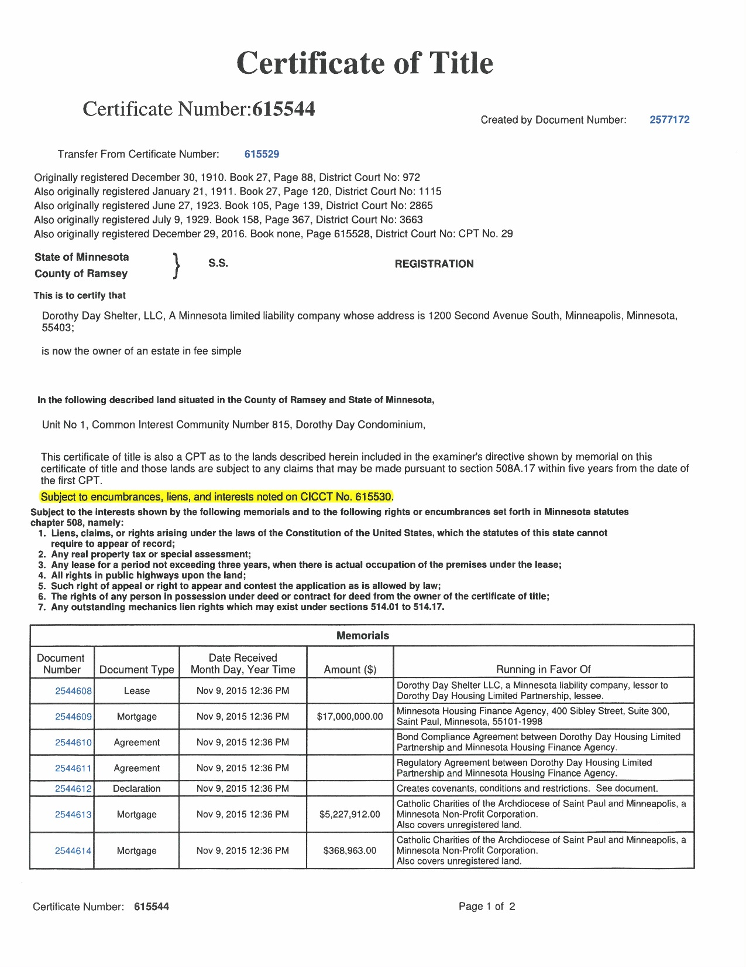
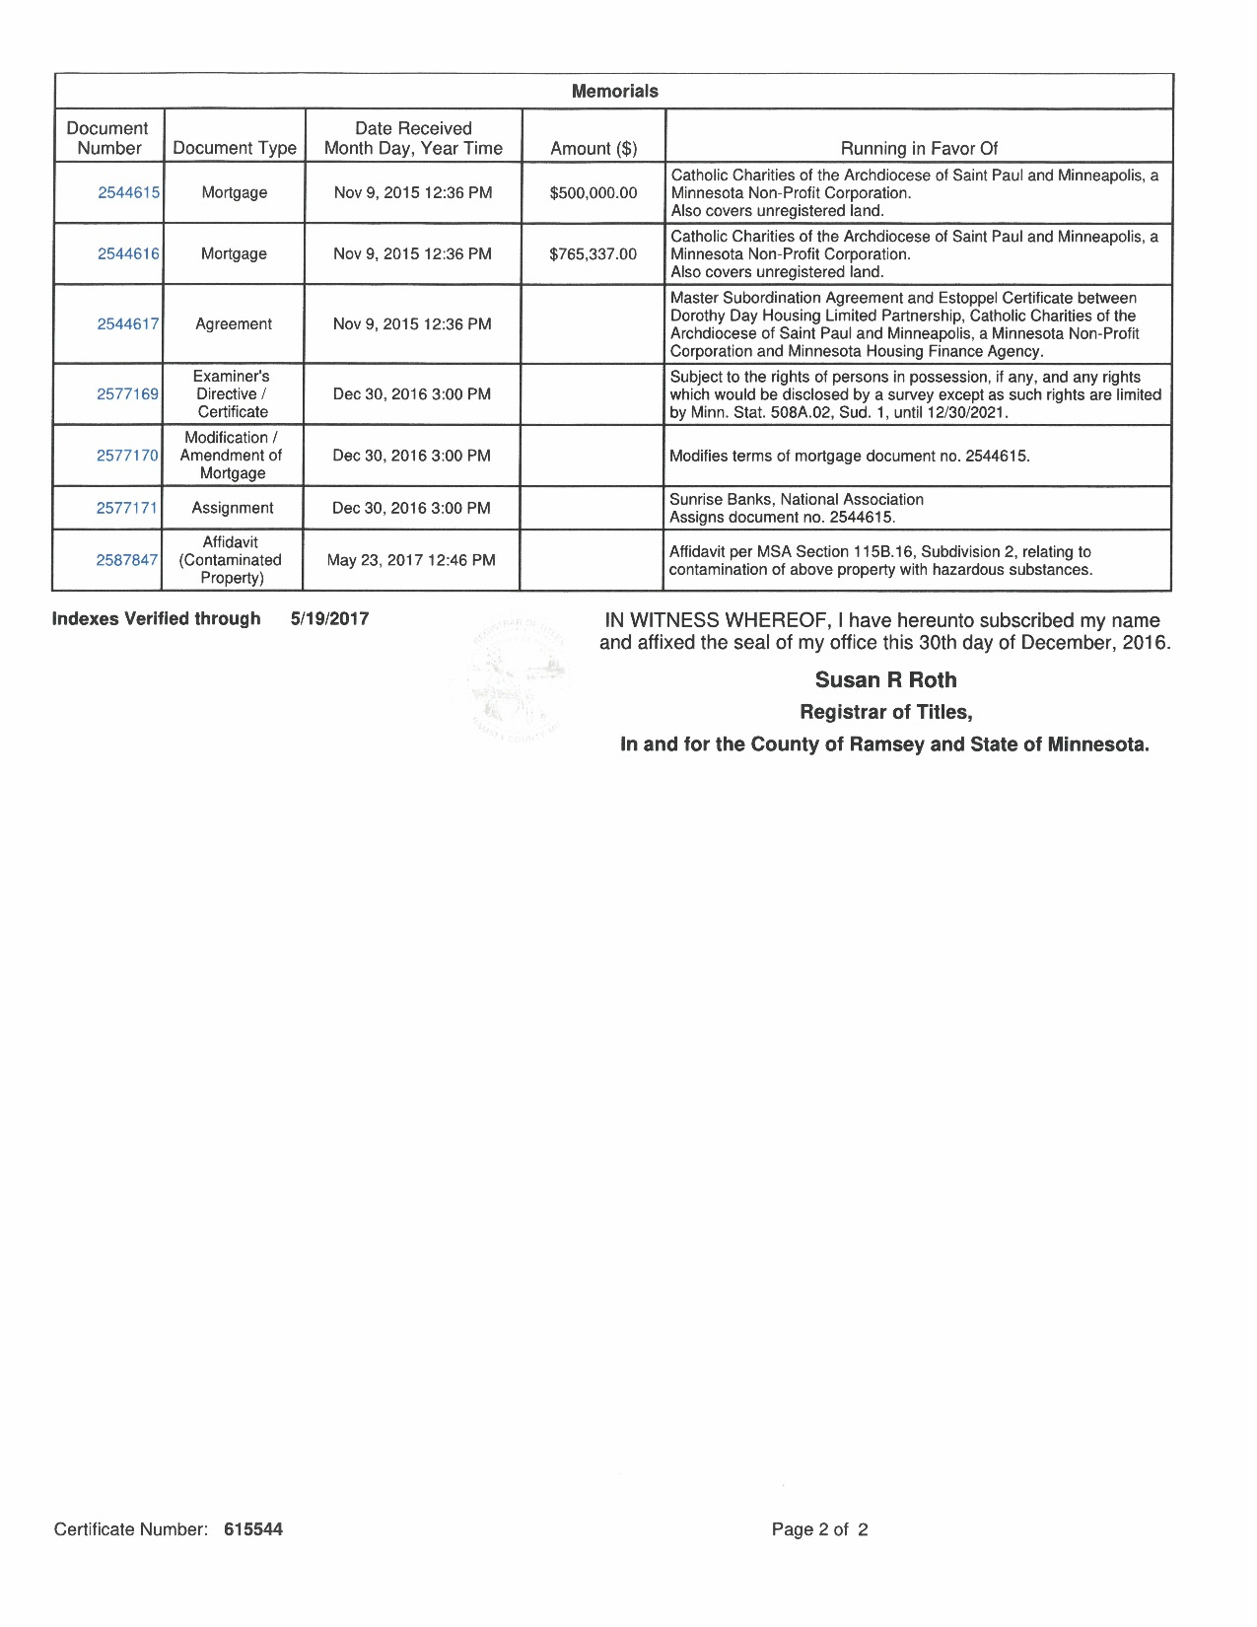

Slide 20
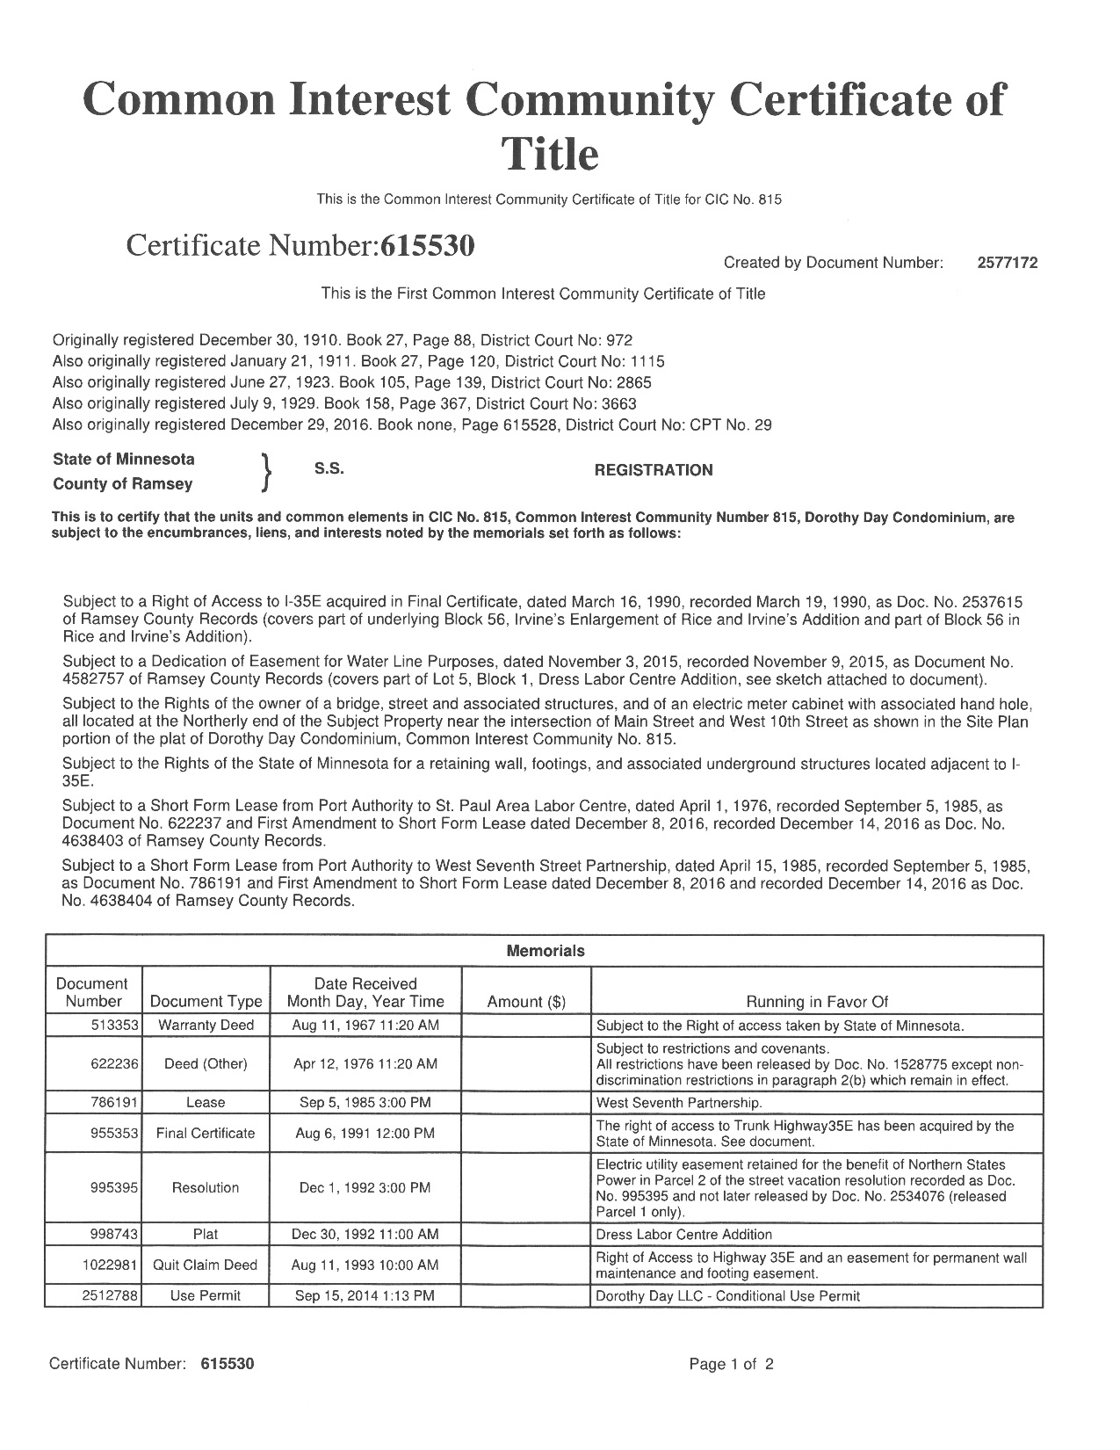
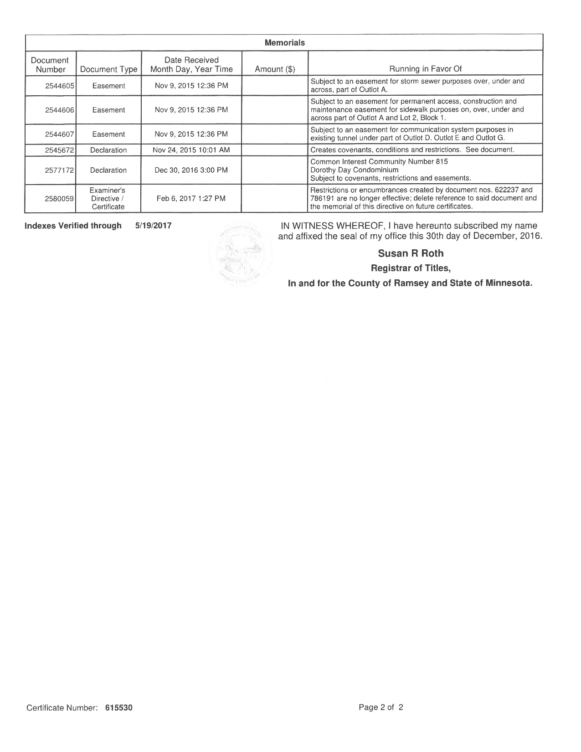

Slide 21
Is an Examiner’s Directive (508.62) required for a “Corporate Trust” as defined by
Minn. Stat. Sec. § 501C.0102(c)?

Slide 22
• Is a Directive required for a Power of Attorney in Torrens?
• If so, when is the Directive required-
• Deed
• Contract for Deed
• Mortgage

Slide 23
What if the husband is the registered owner on the Certificate of Title, may his wife join the Deed or Mortgage with a Power of Attorney?
• Would a Directive be required?

Slide 24
The Certificate of Title is in the name of Alice, the registered owner. Deed comes in with two grantors and proper signatures, etc.: Alice, single and I.M. Stranger, single. I.M. Stranger appears nowhere on the Certificate of Title.
• Is the Deed acceptable for Transfer?
• What about a TODD?

Slide 25
Is the answer different for a Mortgage joined by a non-registered owner?
• Mortgage includes Legal Descriptions for several parcels. Both abstract and Torrens. Each parcel has a different owner, and all owners have signed the mortgage.

Slide 26
Mortgage covers both Torrens and Abstract property. Mortgage Satisfaction is filed only
in Abstract.
• How do you get the Torrens Mortgage satisfied?
• Same, but mortgage was only filed in abstract.
Error discovered when satisfaction is filed. What should be done?

Slide 27
Same facts, except the Mortgage Satisfaction only recites the document number from Abstract.
• How do you get the Torrens Mortgage Satisfied?

Slide 28
When may a Survey be memorialized on the Certificate of Title?
• Why file the survey?
• How is that to be done?

Slide 29
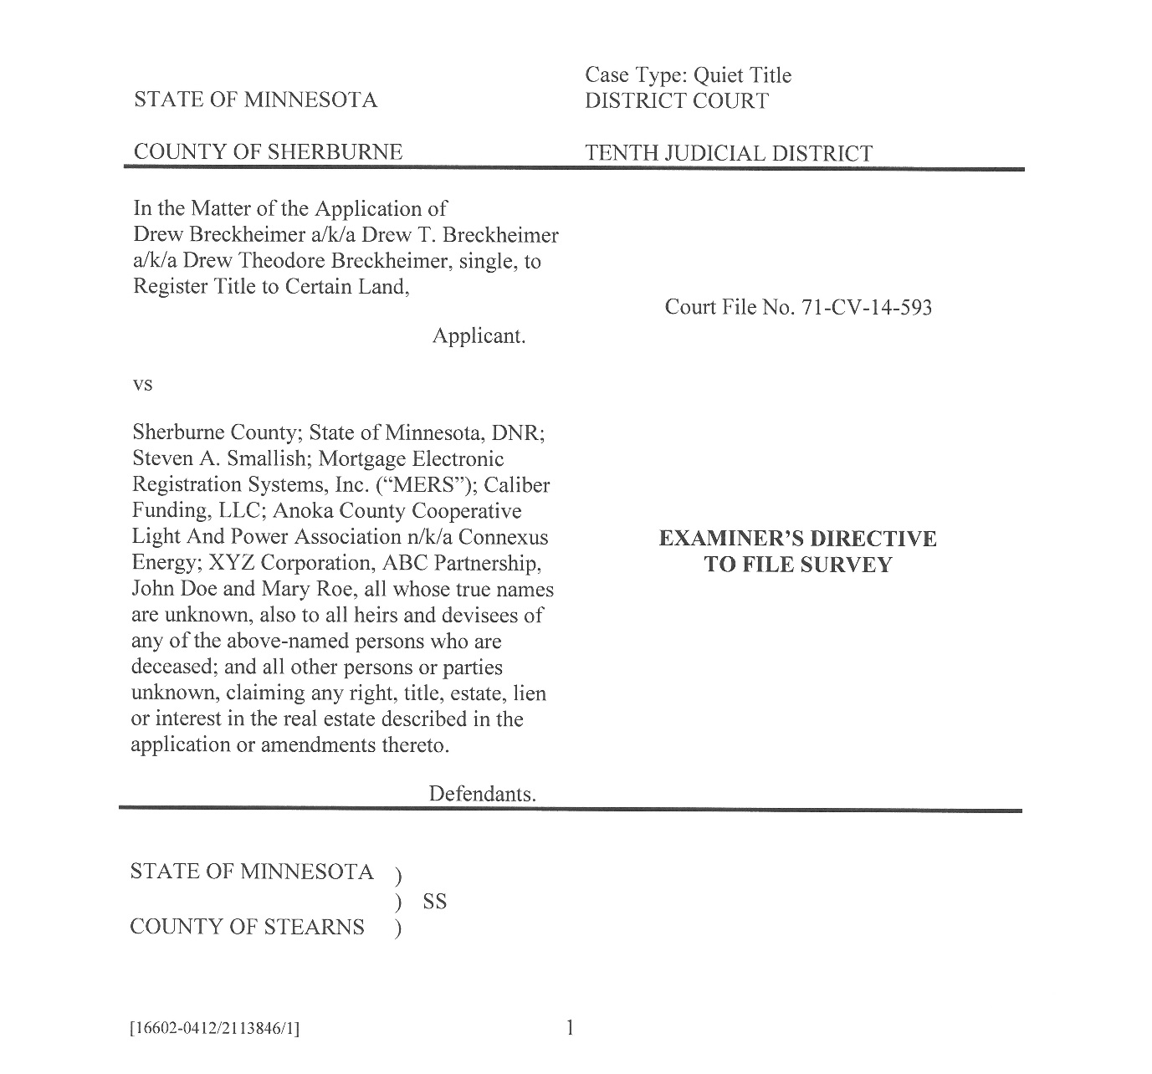

Slide 30
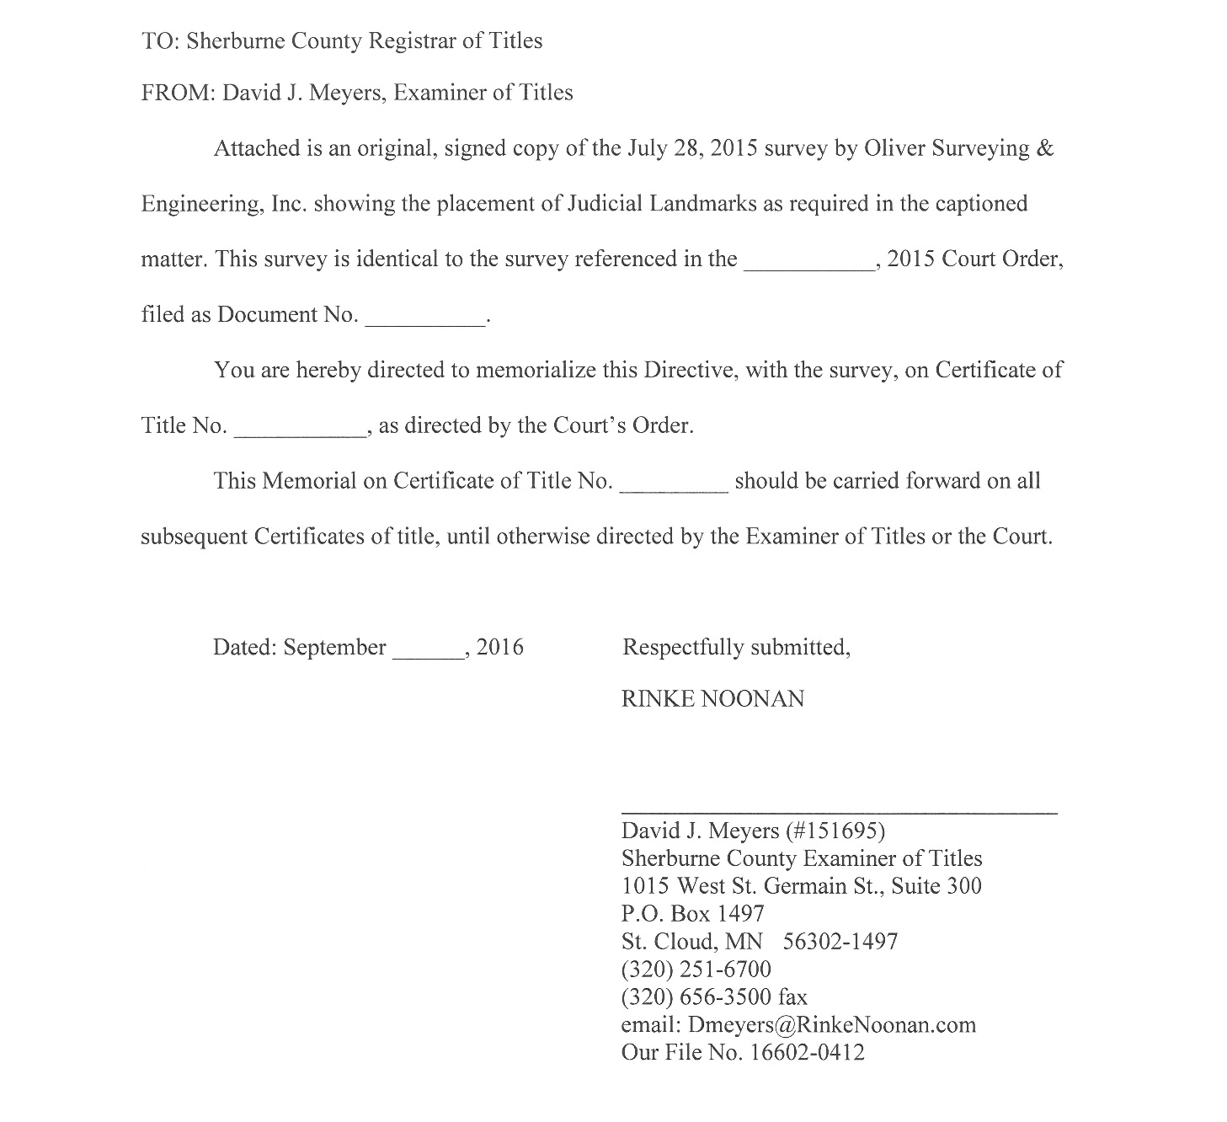

Slide 31
How did you find someone qualified to be an Examiner of Titles? 508.12
Does the Examiner need to reside or practice law in the County? 508.12
What is the job of the Examiner of Titles? 508.13

Slide 32
Is the Registrar of Titles involved in the appointment of the Examiner of Titles? 508.13
How does the Examiner work with the Registrar of Titles?
How are the Examiner’s fees determined? 508.12

Slide 35
Tax Forfeitures
• Legal description (L/D) on Auditors
Certificate (AC) does not match L/D on C/T.
• L/D on state deed matches C/T.
A. A/C < 10 years of record
B. A/C > 10 years of record

Slide 36
Legal Description (L/D) on deed does not exactly match L/D on C/T.
• How close is close enough?

Slide 37
May a document be accepted and memorialized if less than all registered owners sign?

Slide 38
Should a Registrar not show the marital status of an owner of Torrens property in the first paragraph of a Certificate of Title and just make sure of that status and that any spouse joins in at the time of any conveyance?
• Minn. Stat. § 508.23, Subd. 1 states: “Every decree
of registration shall . . . state whether the owner is 18 years of age or older, and whether married, or unmarried, and, if married the name of the spouse. . ..” but Minn. Stat. § 508.35, in prescribing the form of a certificate contains no reference to including a spouse’s name if not in title.

Slide 39
• What happens if on Certificate, after owner’s name in the first paragraph, it states owner is single, and then a mortgage comes in showing the owner is married and then, subsequent to that, a deed is received showing the owner as single?
• If the property is owned by just one individual, should that person’s marital status be reflected in the first paragraph of a Certificate of Title if the document by which the ownership interest was created shows his/her marital status?

Slide 40
A & B own property as Joint Tenants.
B is married to C. Does C have marital interest in the property? Minn. Stat. Sec 507.02
Does a non-titled spouse have a marital interest in property owned by the other spouse in joint tenancy with another?

Slide 41
Upon death of a non-titled spouse, is proof of death required to terminate their interest?
• Assume that Registrar has notice of spouse

Slide 42
Certificate in the name of John Doe and Mary F. Doe; Summary Real Estate Disposition Judgment provides that property is awarded to Mary Francis
Doe.
Does SREDJ need to be reviewed by Examiner?
How should name of owner be shown on new Certificate?
What if SREDJ says Mary E. Doe gets the property?

Slide 43
May a Land Surveyor’s Certificate of Correction to Plat be accepted for a memorial?
• What are the alternatives?

Slide 44
Registered owner sells land on C/D.
C/D has been memorialized.
Deed is later filed.
• Terms of C/D are Deed are consistent
• Terms of C/D and Deed are inconsistent

Slide 45
Probate v. Proceedings Subsequent
2 registered owners. No designation on nature of ownership. One Dies.
Survivor claims ownership as surviving J/T.
What can be done?
• Probate- Preferred
• Proceedings Subsequent?

Slide 46
When should an RLS be required?
  A. Less than an aliquot part.
  (i.e.: NW ¼ SW ¼, or E ½ NW ¼)
  B. Avoid confusion.
  (i.e.: NW ½ except deed Doc. No’s. 12345, 678910, 111213 and land south of highway)

Slide 47
Registered owner =
John Boe + Cheryl Boe, married, as Trustees of John + Cheryl Boe Trust
Transfer-
Certificate of Trust + Affidavit of Trustee Both signed by only John Boe as sole Trustee.
John Boe, Trustee conveys to John Boe,
then files TODD, by John Boe single.

Slide 48
Can a Registrar remove one or more mortgages running to the same mortgagee if there is a deed from the record owner to the mortgagee that merges title?

Slide 49
You have adjoining properties, only one is Torrens, but both are subject to the same driveway easement.
Should every transfer of the abstract property be memorialized on the certificate of title?

Slide 50
There is an easement over abstract property that benefits registered property; should the easement be referenced on the Certificate of Title?
  A. What if the easement is over another piece of registered property?
  B. What if the easement is on registered property but benefits abstract property?

Slide 51
Thank You!
Cheryl Perish Todd County Registrar of Titles and Country Recorder
cheryl.perish@co.todd.mn.us
Robert Russell Russell Law Office, Otter Tail County Examiner of Titles
Robert@russelllawoffice.com
Wayne Anderson Ramsey County Examiner of Titles
Wayne.Anderson@CO.RAMSEY.MN.US
David J. Meyers Sherburne, Mille Lacs, Roseau, Kittson, Marshall
and Wilkin County Examiner of Titles
dmeyers@rinkenoonan.com
For a copy of today’s presentation visit:
www.rinkenoonan.com

