Slide 1
North Corner Section 6, Township 39 North, Range 29 West, Morrison County, Minnesota
Presented by: David J. Meyers
dmeyers@rinkenoonan.com

Slide 2
WWW.MNGEO.STATE.MN.US/GLO

Slide 4
Fourth Principal Meridian (P.M.)
East of the Mississippi
Baseline – South boundary of Wisconsin
Township North, range West or East
Six mile (sections) long segments, called townships, North of the baseline and West or East of the North South meridian, called range
Example: Township 39 North, Range 29 West

Slide 5
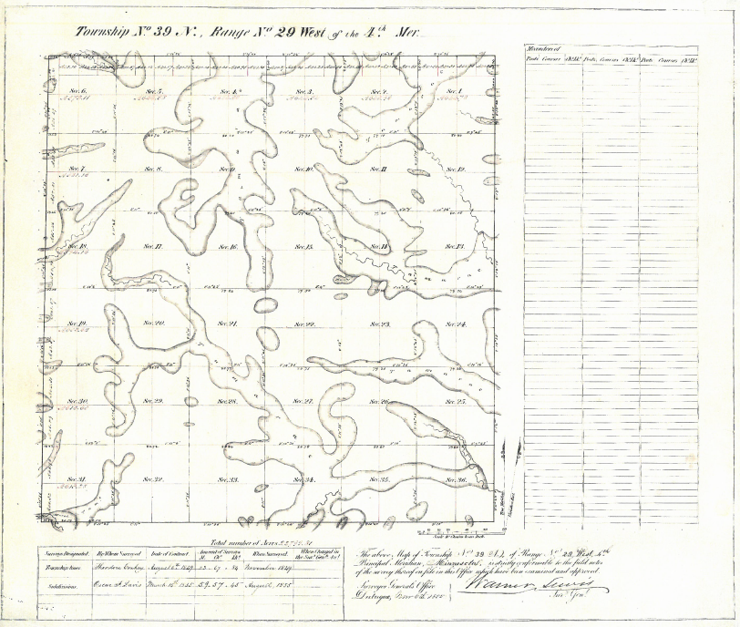

Slide 6
Government surveyors first ran the exterior township lines using latitude and longitude.
Later Government surveyors laid out the interior township lines, starting at the Southeast corner, designated as Section 36.
Work proceeded West and North within the township.

Slide 7
Eight government corners were set on each section. The center of section was calculated.

Slide 9
The problem today is locating the original government corners.
The cardinal rule is that the section corners are where they were placed by the government surveyor.

Slide 11
At the West and North quarter quarters, lotting was required.
These quarter quarters could be more or less than 40 acres.

Slide 12
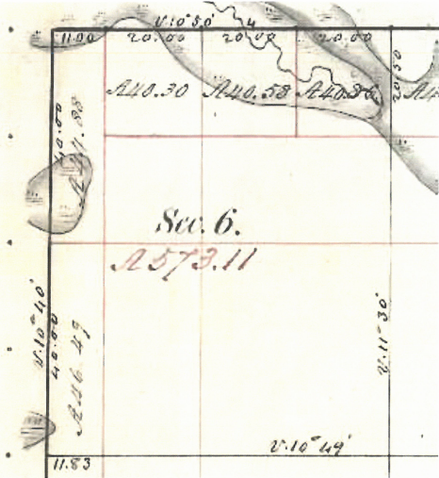

Slide 13
Government lots were sold by acreage, not by survey or aliquot part.
This makes them extremely difficult to resurvey today.

Slide 14
Locating the original government survey corner is the key to a resurvey

Slide 15
Corners are in One of Three States:
Existent - Actual monument located

Slide 16
Corners are in One of Three States:
Obliterated - Corner can be found with other evidence

Slide 17
Corners are in One of Three States:
Lost - Corner can not be found

Slide 18
North Corner Section 6
Two surveyors have decided it is an obliterated corner that can be located with other evidence

Slide 19
Surveyor 1 Set Corner on Town Line in Center of Highway
Based Upon 1902-1904 Hillman Town Road Order
And 1958-1959 County Highway Field Notes

Slide 20
Surveyor 2
Reset corner based upon a work by prior county surveyor done in 1901
And 1907 Morrill Township Road Order

Slide 21
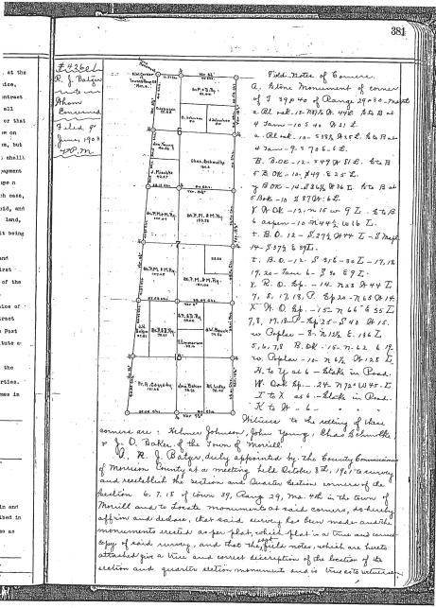

Slide 22
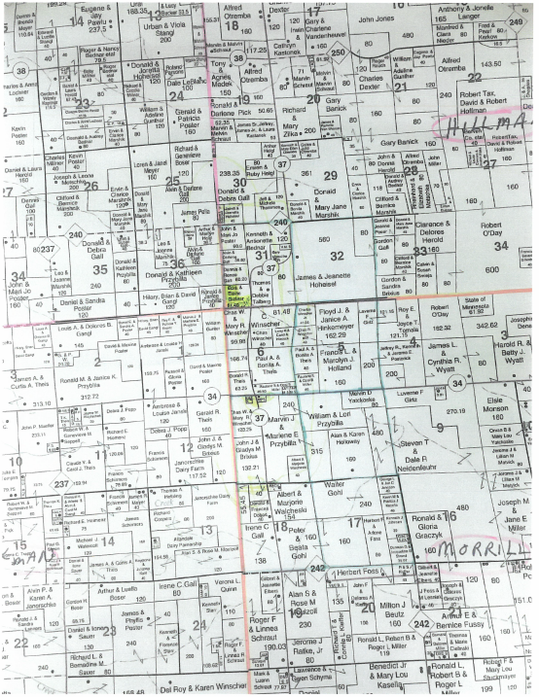

Slide 23
All Agree on NW Corner
GLO – 1855
NW North Corner
20 + 11 = 31 Chains, 2046 Feet

Slide 24
Morrison Highway and March 8, 2012 Private Surveyor – Certificate of Location
NW North Corner
1755.27 Feet

Slide 25
1901 and 2017 County Surveyors
NW North Corner
1106.82 Feet

Slide 26
Compare:
GLO – 2046 Feet
Highway/Private – 1755.27 Feet
1901 & 2017 County – 1106.82 Feet

Slide 27
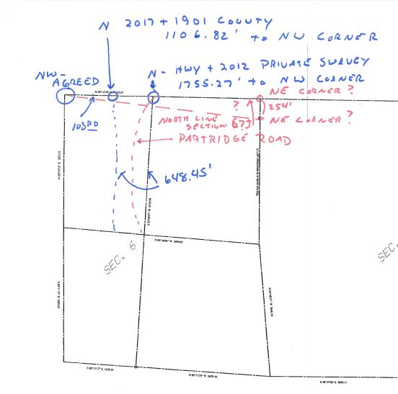

Slide 28
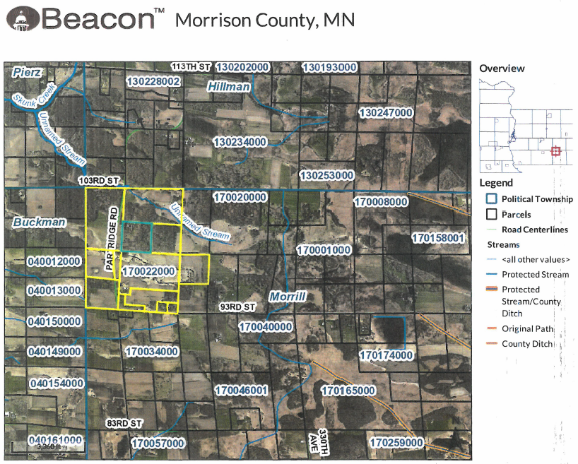

Slide 29
Morrison County is Obligated by State Law to:
Have a surveyor locate and monument original government corners

Slide 30
Morrison County has No Obligation or Authority to:
Decide boundaries of private land

Slide 31
Morrison County May:
Do Nothing
These are private land boundary matters

Slide 32
Morrison County Could:
Ask the court to determine the location of the government corners
Then leave land owners to sort out their boundaries on their own

Slide 33
Morrison County Could Establish:
A Boundary Commission
Minn. Stat. § 465.79

Slide 34
Boundary Commission Procedure:
Resolution by County Board
Appoint commission member
Must be residents of Morrison County

Slide 35
Boundary Commission Procedure:
Review legal descriptions and surveys
Attempt to get agreement with land owners on boundaries

Slide 36
Boundary Commission Procedure:
If no agreement, make recommendation to County Board
Prepare plat designating all boundary lines

Slide 37
Boundary Commission Procedure:
County Board holds a hearing
County makes adjustments if needed and approves plat
Court approval after notice and hearing

Slide 38
Boundary Commission Procedure:
Place judicial landmarks
File plat

Slide 39
Boundary Commission Procedure:
County may access cost to land owners.

Slide 40
A Boundary Commission Plat:
Creates a new legal description for each parcel
Example:
Prior: SW ¼ NW ¼ Sec. 6, Township 39, Range 29
New: Lot 6, Morrison County Boundary Commission Plat No. 1

Slide 41
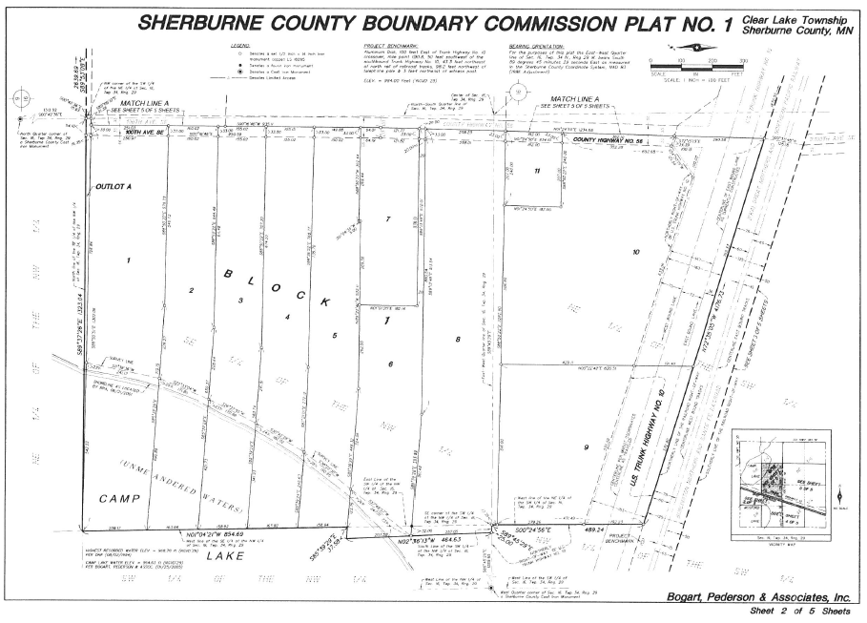

Slide 42
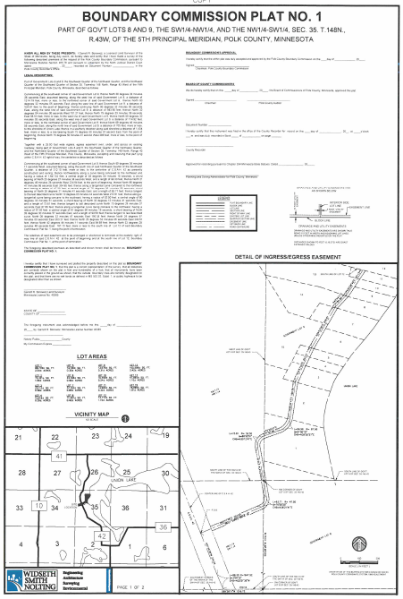

Slide 43
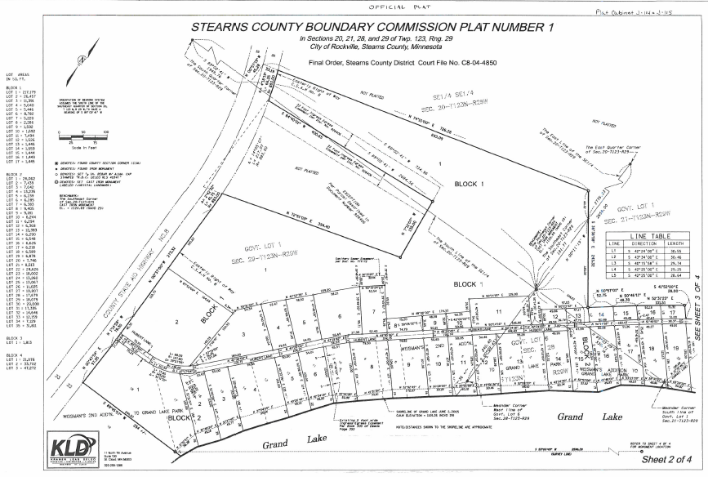

Slide 44
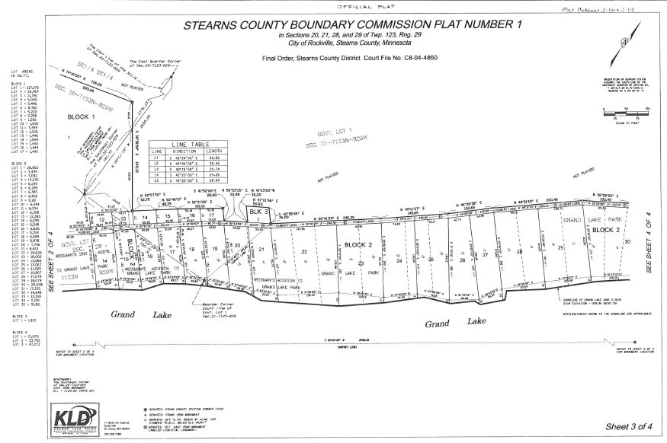

Slide 45
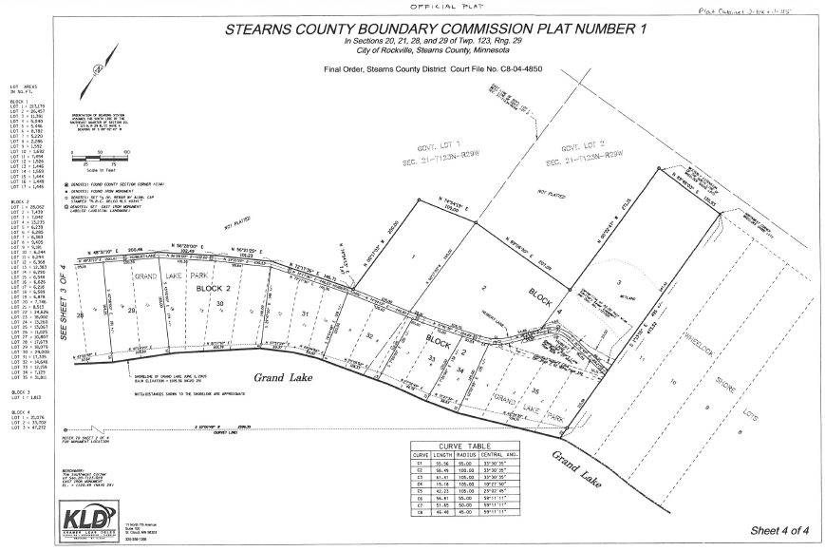

Slide 46
Questions
Will I lose land?
You will own what you have possessed.

Slide 47
Questions
I have paid real estate taxes on 40 acres, but the Boundary Commission says I will own 36 acres. Do I get a tax refund?
The county has no authority to rebate tax payments.
Future real estate taxes will be based upon the boundary commission plat.

Slide 48
Questions
I just had my land surveyed. Why should I be part of a Boundary Commission?
Your survey may no longer be accurate because the government corners are in question.

Slide 49
Questions
I do not want to be part of the Boundary Commission Plat
Tell the County Board, but if your neighbors are part, your boundary may be fixed by the plat.

Slide 50
Questions
How much will this cost?
It depends on how many parcels are involved
Survey Costs
How many people argue

Slide 51
Questions
How much will this cost? (cont.)
Legal fees for title work, filing fees, etc.
e. Lots are reduced on a per parcel basis when more parcels are involved.

Slide 52
Questions
How much will this cost? (cont.)
What is the personal cost of arguing with your neighbors?
g. What is the benefit of sleeping nights and not dealing with a crabby spouse?

Slide 53
Questions
What is the cost if I do this on my own?
It depends upon neighbor argument, mortgage companies, survey, title problems, and more.

Slide 54
Questions
What is the cost if I do this on my own? (cont.)
No contest estimate: $4,500-$7,000
Contest estimate: $25,000+

Slide 55
Questions
What is the cost if I do this on my own? (Cont.)
What is the personal cost of fighting with your neighbors?

Slide 56
Thank you! David J. Meyers Rinke Noonan Phone: 320.251.6700 Toll Free: 888.899.6700 Direct Dial: 320.656.3512 Email: Dmeyers@rinkenoonan.com

