Slide 1
Eclectic Law for Surveyors
2021 MSPS Annual Conference
By David J. Meyers
Dmeyers@RinkeNoonan.com

Slide 2
Minn. Stat. § 541.02 - Recovery of Real Estate, 15 years
No action for the recovery of real estate or the possession thereof shall be maintained unless it appears that the plaintiff, the plaintiff's ancestor, predecessor, or grantor was seized or possessed of the premises in question within 15 years before the beginning of the action.
Such limitations shall not be a bar to an action for the recovery of real estate assessed as tracts or parcels separate from other real estate, unless it appears that the party claiming title by adverse possession or the party's ancestor, predecessor, or grantor, or all of them together, shall have paid taxes on the real estate in question at least five consecutive years of the time during which the party claims these lands to have been occupied adversely.

Slide 3
Minn. Stat. § 541.02 - Recovery of Real Estate, 15 years
The provisions of the preceding paragraph shall not apply to actions relating to the boundary line of lands, which boundary lines are established by adverse possession, or to actions concerning lands included between the government or platted line and the line established by such adverse possession, or to lands not assessed for taxation.

Slide 4
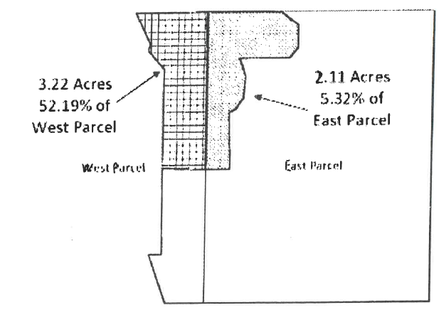
St. Paul Park Refining Co. LLC v. Domeier, 950 N.W.2d 547 (2020)

Slide 5
Minn. Stat. § 160.05, Subd. 1 – Dedication of Roads
Six years. (a) When any road or portion of a road has been used and kept in repair and worked for at least six years continuously as a public highway by a road authority, it shall be deemed dedicated to the public to the width of the actual use and be and remain, until lawfully vacated, a public highway whether it has ever been established as a public highway or not. Nothing contained in this subdivision shall impair the right, title, or interest of the water department of any city of the first class secured under Special Laws 1885, chapter 110. This subdivision shall apply to roads and streets except platted streets within cities. If a road authority fails to give the notice required by paragraph (b), this subdivision does not apply.

Slide 6
Minn. Stat. § 160.05, Subd. 1 – Dedication of Roads
(b) Before a road authority may make any repairs or conduct any work on a private road as defined by section 169.011, subdivision 57, the road authority must notify the owner of the road of the intent to make repairs or conduct work on the private road. The notice must be sent to the owner by certified mail. The notice must specify the segment of road that is the subject of the notice and state the duration of the repairs or work. The notice must include the following: "Pursuant to Minnesota Statutes, section 160.05, your private road may be deemed to be dedicated to the public if the following conditions are met for six continuous years: (1) the road is used by the public; and (2) the road is repaired or worked on by a road authority. This means that the road will no longer be a private road but will be a public road. You will not receive compensation from the road authority when the road is dedicated to the public."
<Title?>

Slide 7
Minn. Stat. § 160.05
History: 1959 c 500 art 1 s 5; 1973 c 123 art 5 s 7; 1982 c 424 s 40; 1984 c 562 s 5; 2020 c 100 s 1
NOTE: The amendment to subdivision 1 by Laws 2020, chapter 100, section 1, is effective August 1, 2020, and applies to any repairs, maintenance, or work newly started on a private road on or after that date. This section does not apply to a road segment for which: (1) repair or work started before August 1, 2020; or (2) a road authority has continuously maintained since before August 1, 2020. Laws 2020, chapter 100, section 1, the effective date.

Slide 8
Minnesota Title Standards – Three Parts
Green pages – what is acceptable (Marketable v. Insurance Title)
White pages – how to transfer title
Guidelines for legal descriptions and surveys

Slide 9
Minnesota Title Standards
8. Marital Status of Grantor – Deed of “Widow” or “Widower”
9. Marital Status of Grantor – No Prior Marriage Shown
10. Marital Status of Grantor – Prior Marriage of “Widow” o r “Widower”
11. Marital Status of Grantor – Prior Marriage of Person Designated “Single” or “Unmarried”

Slide 10
Minnesota Title Standards
57. Vacated Streets and Alleys
58. Assignment, Release, or Satisfaction of Rerecorded and Corrective Mortgages
76. Contract for Deed – Transfer of Seller’s or Purchaser’s Interest

Slide 11
Minnesota Title Standards
87. Conveyances – Dissolution of business or Professional Corporations
  87.1 Business Corporations Organized Under Chapter 301 Which Have Filed a Resolution for Voluntary Dissolution Before January 1, 1984
  87.2 Corporations Governed by or Organized Under Chapter 302A
88. Minimum Requirements for Planned Communities
  88.1 Evidence of Title
  88.2 Minimum Requirements for the Declaration
89. Conveyance from Surviving Joint Tenant

Slide 12
Minnesota White Pages – Chapter 1, Instruments Required to Transfer Title to Real Property
B. Conveyances by Individuals
  1. Conveyances by Married Individuals
  2. Conveyances Between Married Individuals
  3. Conveyances Following Dissolution of Marriage
  4. Joint Tenancy
  5. Conveyances Following Termination of Life Estate
  6. Conveyances by Execution of Power of Appointment
D. Deeds from Corporations or LLCs
  1. Corporate Authority
  2. Business Corporations Under Minn. Stat. Ch. 302A
  3. Corporations Under Minn. Stat. Ch. 300
  4. Nonprofit Corporations
  5. Religious Corporations

Slide 13
Minnesota White Pages – Chapter 1, Instruments Required to Transfer Title to Real Property
H. Trustee Deeds
  1. General Comments
  2. Interest Held by Trustee Under Inter Vivos Trust Containing a Power of Sale
  3. Interest Held by Trustee Under Testamentary Trust Containing a Power of Sale
  4. Interest Held by Trustee Under Inter Vivos or Testamentary Trust Not Containing a Power of Sale

Slide 14
Minnesota White Pages – Chapter 2, Instruments Required to Remove Encumbrances
A. Mortgage When There Has Been No Foreclosure Sale
B. Mechanic’s Lien
  1. No Notice of Lis Pendens of Record
  2. Notice of Lis Pendens of Record
  3. Judgment Entered But No Sheriff’s Sale
  4. Judgment Entered and Sheriff’s Sale Held
C. Lien Created by Judgment for Money

Slide 15
Minnesota White Pages – Chapter 3, Methods Suggested for Clearing Objections to Title
1. Correct the Recorded Instrument and Re-record It
2. Obtain and Record a Corrective Instrument
3. Use Additional Words of Identification of Parties in Subsequent Instruments
4. Obtain and Record Affidavit
5. Cancellation of Contract for Deed or Purchase Agreement
6. Actions

Slide 16
Guidelines for Legal Descriptions and Survey Matters
Introduction
These guidelines are not title standards, but rather a set of tools available to an attorney to resolve issues that may arise when reviewing a legal description or survey. They seek to summarize key elements of both law and scholarly works pertaining to specific issues which may arise. In some instances, they are based upon generally accepted survey practices. The guidelines are intended to make available to an attorney a starting point for analyzing a legal description or survey

Slide 17
Guidelines for Legal Descriptions and Survey Matters
1. Ambiguities
  1.1 Recorded Evidence
2. Government Surveys
  2.1 Original Government Survey Reconciliation
3. Priority Given to Original Monuments
  3.1 Original Monuments Control
4. Obliterated or Lost Corners in Government Survey or Subdivision Plat
  4.1 Obliterated Corners
  4.2 Lost Corners

Slide 18
Guidelines for Legal Descriptions and Survey Matters
5. Rules of Construction for Legal Descriptions
  5.1 Rules of Construction Order of Controlling Authority
    5.1.1 Natural Monuments
    5.1.2 Artificial Monuments – Original
    5.1.3 Artificial Monuments – Other than Original
    5.1.4 Plat of Survey
    5.1.5 Surveyor’s Field Notes
    5.1.6 Calls
    5.1.7 Distance
    5.1.8 Quantity / Acreage
6. Deficiency or Shortage of Land in a Subdivision Plat
  6.1 How Shortage is Allocated

Slide 19
Guidelines for Legal Descriptions and Survey Matters
7. Government Lots
8. Riparian Rights
  8.1 Presumption
  8.2 Intent to Reserve
  8.3 Boundary Lines on a Plat
9. Meander Lines
  9.1 Government Meander Lines
  9.2 Low / High-Water Mark

Slide 20
Guidelines for Legal Descriptions and Survey Matters
10. Minor Discrepancies in Measurement
11. Reference to a Roadway in a Legal Description
12. Auditor’s Plats
13. Basis of Bearings
14. Aliquot Parts
15. Establishing Boundaries Judicially

Slide 21
Guideline No. 12 – Auditor’s Plats
The purpose of auditor’s plats as authorized by Minn. Stat. § 272.19 is designate and describe certain irregular tracts of real property for assessment and taxation purposes. Conveyances of real property included in an auditor’s plat can be made by using the metes and bounds description or the auditor’s lot number and plat name assigned to it.
Auditor’s plats are seldom established anymore. At creation, the surveyor was required to show any variation between measurements of the tract as actually surveyed and the measurements stated in the instruments of conveyance with respect to any lot to be outlined upon the plat and the surveyor was to state in a certificate endorsed upon the plat the extent of the variation and the action taken to reconcile such difference(s). A discrepancy may be of such a nature as to be resolved by application of Minn. Stat. § 541.023 or as otherwise hereafter stated.

Slide 22
Guideline No. 12 – Auditor’s Plats
An error in an auditor’s plat may be corrected by revising it in accordance with Minn. Stat. § 272.19, making a new auditor’s plat, making a plat in accordance with Minn. Stat. Ch. 505, conveyance or legal action. The amendment provisions of Minn. Stat. §§ 505.174 and 505.175 may not be used to correct errors in an auditor’s plat, nor may streets, alleys or other public uses be dedicated in an auditor’s plat.

Slide 23
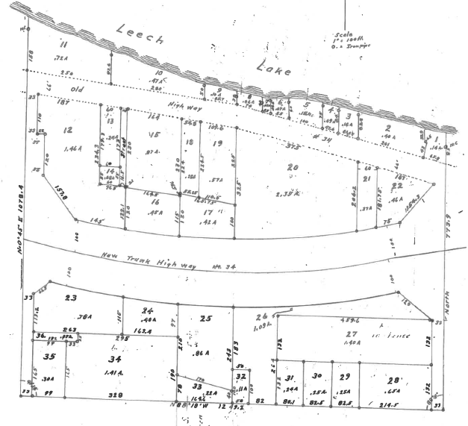
Auditor’s Plat No. 11, Cass County, Minnesota

Slide 24
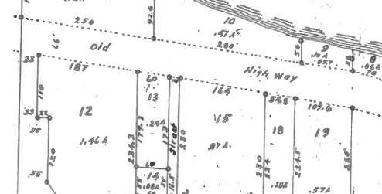
Auditor’s Plat No. 11, Cass County, Minnesota

Slide 25
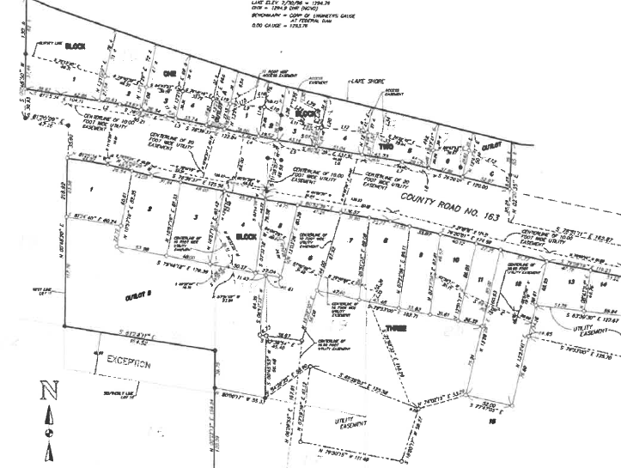

Slide 26
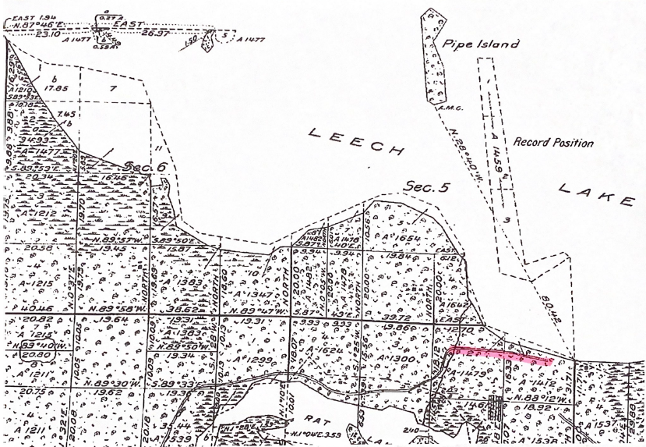

Slide 27
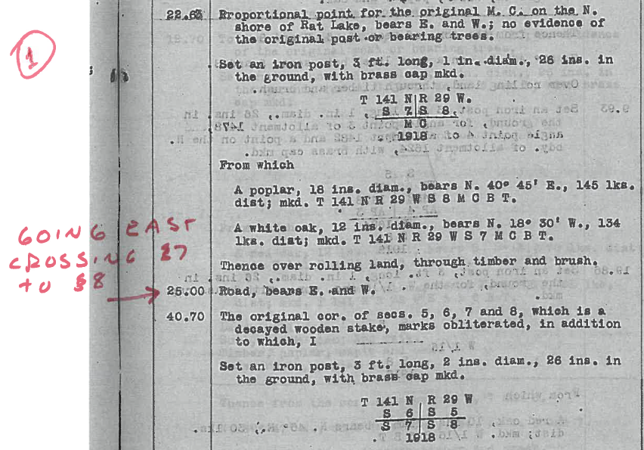
Re-Establishment of Exterior and Subdivisional Lines, 1918

Slide 28
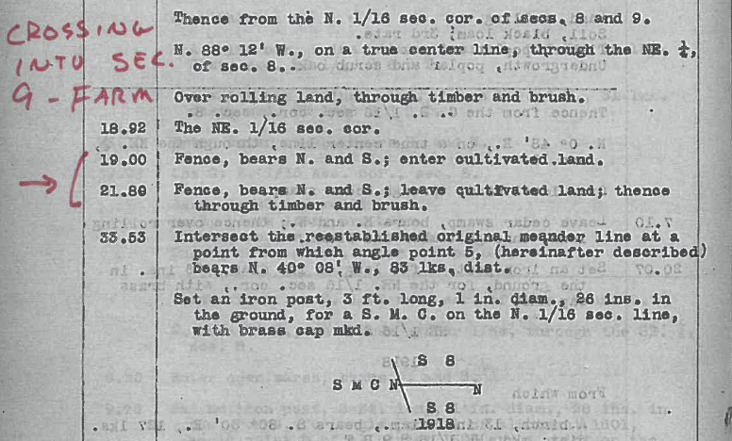

Slide 29
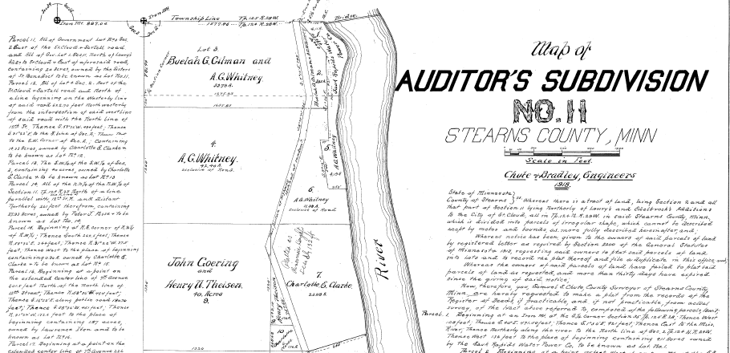

Slide 30
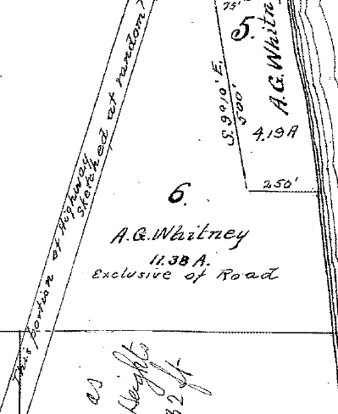
“This portion of Highway sketched at random?”

Slide 31
Guideline No. 10 – Minor Discrepancies in Measurements
Surveying is the art of measurement, not an exact science. Changes in nature generally, as well as human nature, and differences in instrument accuracy often preclude exact duplication of original measurements in a legal description. Minor discrepancies in a resurvey do not necessarily suggest a change in the actual dimensions.

Slide 32
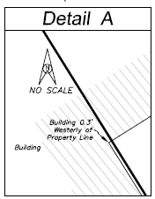
Minor Discrepancies in Measurements

Slide 33

Minor Discrepancies in Measurements

Slide 34
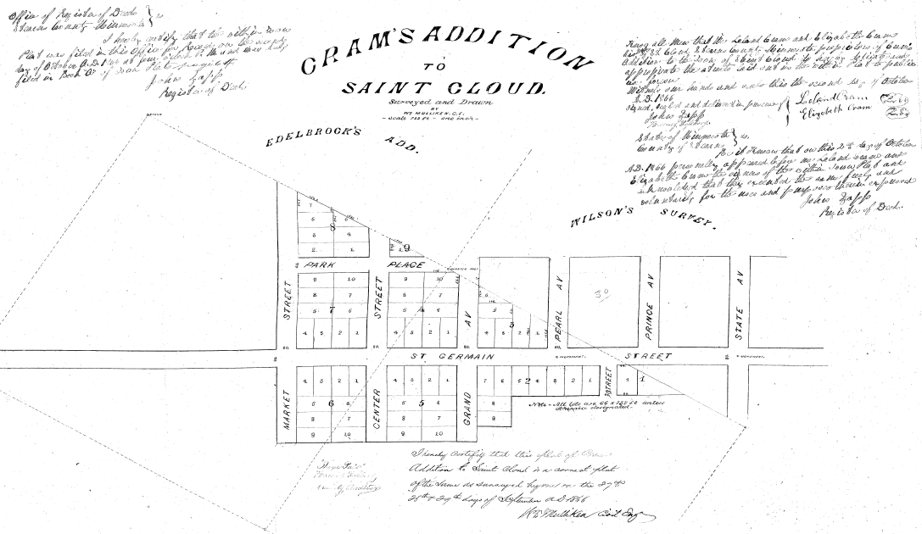
Minor Discrepancies in Measurements
Dated A.D. 1866

Slide 35
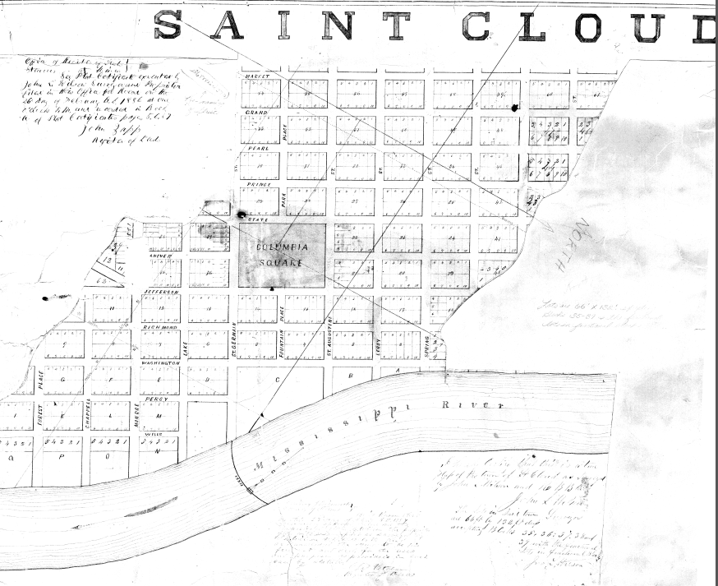
Minor Discrepancies in Measurements
Dated A.D. 1857

Slide 36
Title Registration (Minn. Stat. Ch. 508)
Torrens v. Abstract Title
Registered Title ≠ Registered Boundary

Slide 37
Title Registration (Minn. Stat. Ch. 508)
How to set Judicial Landmarks (JLM) Minn. Stat. § 559.25
  Good Survey – tied to Government Corners with solid Certificates of Location
  Court Action – must include adjoining parcels
  Interlocutory Order – Defendant’s claims are determined and instructs survey to set JLM
  THEN set JLM
  Legal description includes ties to JLM and detailed survey
  Auditor Statement – Minn. Stat. § 559.23

Slide 38
Easements
Appurtenant
Express – look to terms
Prescriptive Easement established by use – usually 15 years
  Limited to historic use, example – access ≠ utilities
  Not allowed for recreation use – Minn. Stat. § 604A.27
Implied Easement / Easement by Necessity
  Courts assume someone will not create a land-locked parcel
Easement in Gross - Personal

Slide 39
Road Dedication
Plat
Road Order
Condemnation
Six years use and maintenance
Common law dedication

Slide 40
Partition
Co-owners right to force sale of real property

Slide 41
David J. Meyers
Rinke Noonan
St. Cloud, MN
(320) 656-3512
Dmeyers@RinkeNoonan.com

